Slide 1

The Trauma-Informed Church:
Where Compassionate Curiosity & Radical
Grace Intersect
Presenter: Missy Blackmer, MSEd, LMFT, LMHC, MBA

Slide 2
Objectives
Defining trauma
ACEs
Trauma Informed Care – the 4 R’s
How to effectively respond to individuals who have trauma: Compassion and Grace

Slide 3
Self-
Awareness
What do you believe about trauma?
What do you believe about individuals with trauma and/or mental health issues?
What is your own history?
What was your childhood experience?
Notes:
TRIGGER WARNING – LEAN INTO YOUR COPING MECHANISMS TODAY

Slide 4

Polling Question:
What is trauma?

Slide 5
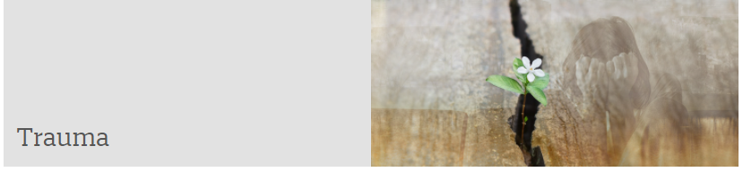
Trauma can be defined using the 3 E’s: An event, series of events, or set of circumstances that is experienced by an individual as physically or emotionally harmful or life threatening and that has lasting adverse effects (SAMHSA, 2014).

Slide 6
Trauma can be…
Abuse
Bullying
Community Violence
Natural Disasters
Domestic Violence
Medical Trauma
Refugee Trauma
Sex Trafficking Victim
Traumatic Grief
Complex Trauma (Complex trauma describes both children’s exposure to multiple traumatic events—often of an invasive, interpersonal nature—and the wide-ranging, long-term effects of this exposure).
Happens at any age

Slide 7

Every person’s
story
starts here
Notes:
Chronic and common stressors can cause significant alternations in a child’s neurodevelopment.
Maternal anxiety/depression have shown to be predictive in some cases of increased risk for neurodevelopmental disorders, including ADHD.
Substance use in pregnancy

Slide 8

Trauma and the Developing Brain
Infant > Neural Connections
Trauma = Interrupted Brain Development
Impact can last through adulthood
Attention/Curiosity damaged
Notes:
As an infant experiences something or learns something for the first time, a strong neural connection is made. If this experience is repeated, the connection is reactivated and becomes strengthened.
For children and youth who experience child abuse or neglect and associated trauma, brain development may be interrupted, leading to functional impairments. Ongoing maltreatment can alter a child's brain development and affect mental, emotional, and behavioral health into adulthood.
They may struggle with sustaining attention or curiosity or be distracted by reactions to trauma reminders. They may show deficits in language development and abstract reasoning skills. Many children who have experienced complex trauma have learning difficulties that may require support in the academic environment.

Slide 9
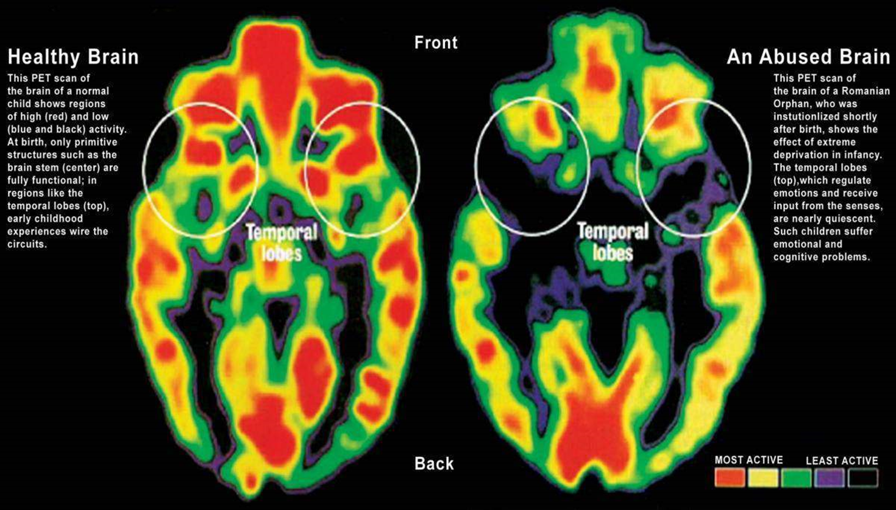

Slide 10
Traumatic experiences can cause…
Sensory reactions
  Frightening visual stimuli
  Loud noises
  Violent movements
  Sensations associated with unpredictable/frightening events
These images continue to be relived through play, nightmares, and other flashbacks

Slide 11
According to The National Child Traumatic Stress Network:
Children who have experienced complex trauma often
  Have difficulty expressing and managing emotions
  Externalized emotions may look like anger/aggression
  Internalized may look like anxiety/depression
  May never learn how to calm themselves down
Dissociation
  Defense mechanism
  Occurs in stressful situations or when faced with trauma reminders

Slide 12
Children who don’t learn to manage emotions and stress become adults who cannot manage emotions/stress.

Slide 13
Adverse Childhood Experiences

Slide 14
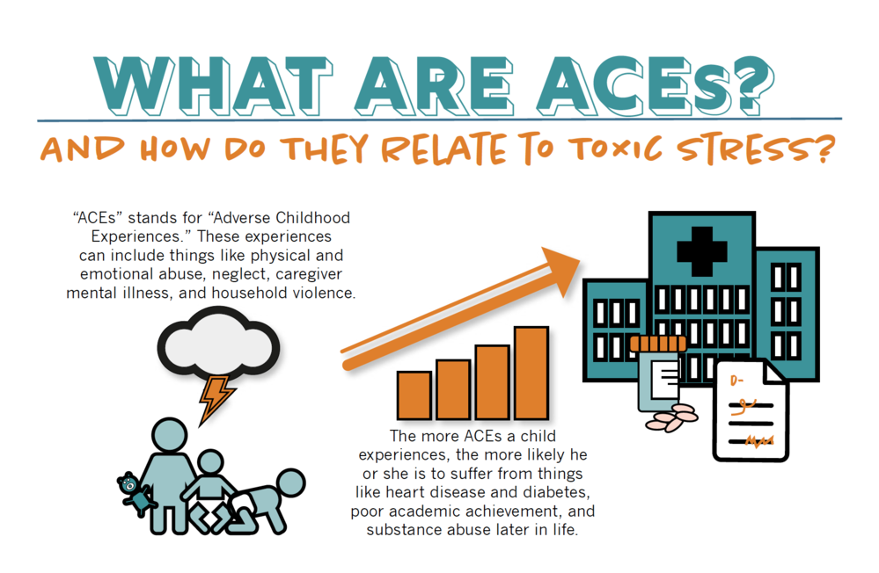
Notes:
The CDC-Kaiser Permanente Adverse Childhood Experiences (ACE) Study is one of the largest investigations of childhood abuse and neglect and household challenges and later-life health and well-being. The original ACE Study was conducted from 1995 to 1997 with two waves of data collection. Over 17,000 participants.
ACEs are common across all populations. Almost two-thirds of study participants reported at least one ACE, and more than one in five reported three or more ACEs.

Slide 15
Polling Question:
How many ACES do you think there are?

Slide 16
ACES Questionnaire
Prior to your 18th birthday:
  Physical abuse
  Sexual abuse
  Verbal abuse
  Physical neglect
  Emotional neglect
  A family member who is depressed or diagnosed with other mental illness
  A family member who is addicted to alcohol or another substance
  A family member who is in prison
  Witnessing a mother being abused
  Losing a parent to separation, divorce or death

Slide 17
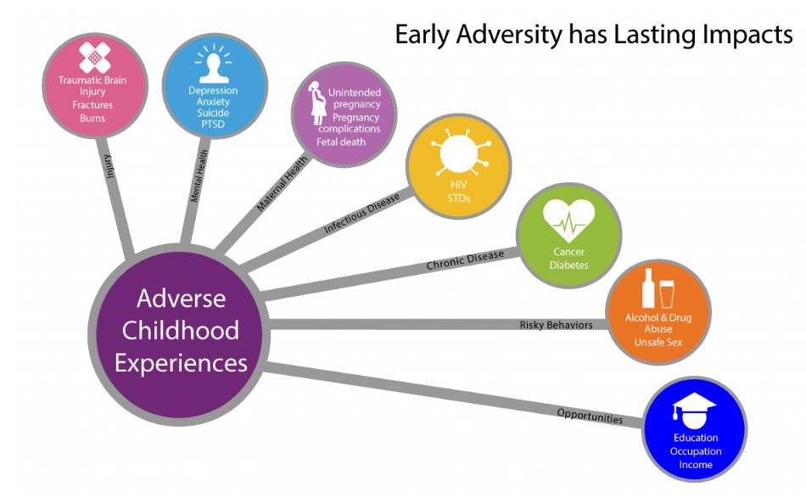

Slide 18
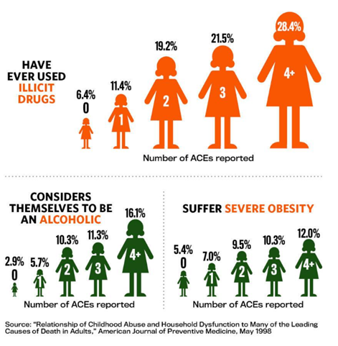
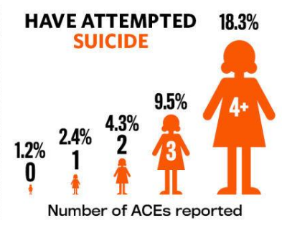
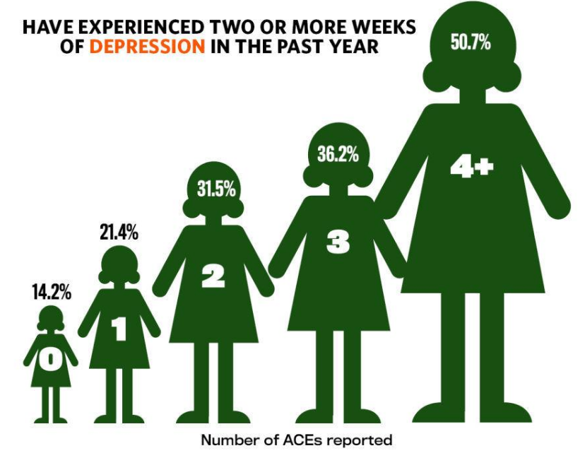
More ACEs = More Risk

Slide 19
The Trauma Informed Church: How to Deliver Trauma Informed Care

Slide 20



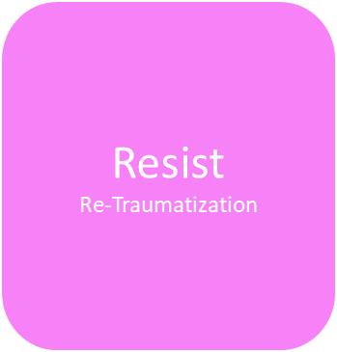
The 4 R’s of Trauma Informed Church
Inspired by SAMHSA and https://www.traumainformedmd.com/churches.html

Slide 21

1 in 5 adults in the US live with a mental illness.
Trauma is a risk factor in nearly all behavioral health and substance use disorders.
Post-traumatic stress disorder (PTSD) is a mental health condition that’s triggered by a terrifying event. Symptoms may include flashbacks, nightmares and severe anxiety, as well as uncontrollable thoughts about the event.
PTSD and other mental health disorders lead to suicidal ideation. 12 million Americans seriously thought about suicide in 2019. 44,834 Americans took their life in 2020. 123 people die each day in the US from suicide.
90% of sexually abused children, 77% of children exposed to a school shooting, and 35% of urban youth exposed to community violence develop Post Traumatic Stress Disorder
70% of adults in the U.S. have experienced some type of traumatic event at least once in their lives. That's 223.4 million people.
Notes:
Trauma Triggers are often connected to 5 senses (implicit memory)
Touch
Avoid touching; especially without permission
Give them space to calm down
Sound
Use calm voice/be aware of tone
May need a quiet space to calm down.
Smell
Scents that can trigger: food, cologne, perfume, flowers, detergent/soap
Sight
Colors, outfits, locations
Taste
Foods

Slide 22
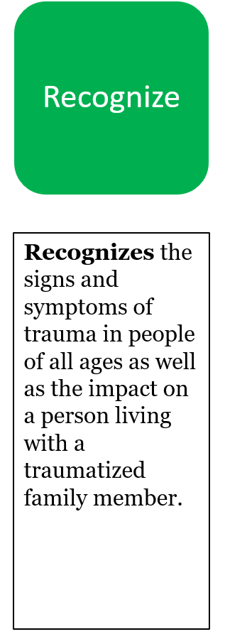
Recognize Trauma Triggers
Triggers
  5 senses
  Holidays
  Seasons
  Birthdays
  Anniversaries of trauma
Common responses when trauma triggered
  Fight
  Flight (avoid/dissociate)
  Freeze
Understanding that behavior is a means of communication; what is the behavior telling you? (Behavior indicates need)
Notes:
Trauma Triggers are often connected to 5 senses (implicit memory)
Touch
Avoid touching; especially without permission
Give them space to calm down
Sound
Use calm voice/be aware of tone
May need a quiet space to calm down.
Smell
Scents that can trigger: food, cologne, perfume, flowers, detergent/soap
Sight
Colors, outfits, locations
Taste
Foods

Slide 23
Being in Relationship with Someone with PTSD
Have a good understanding of PTSD, which can bring unpredictable moods, suicidal ideation, safety issues and caretaking.
Exhaustion and caregiver burnout are real. Encourage the caregiver to invest in self-care, boundaries and even counseling if they indicate they are struggling with anxiety or depression.
Encourage caregivers to seek out support groups.
Notes:
This includes church staff and lay leaders! Set healthy boundaries and know your community resources.

Slide 24
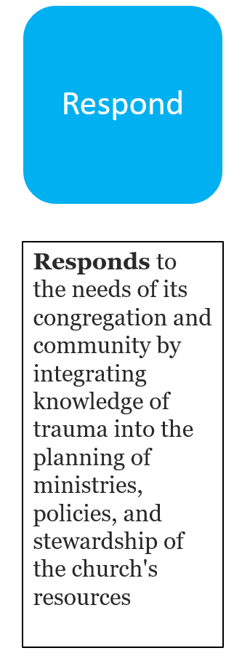
Respond by Fostering Resiliency
Reducing Stress
  Ministries that can meet physical needs of community members can be helpful.
Strengthen Life Skills
  Parenting courses
  Financial Literacy
  Linking to job skills training
  Marriage Enrichment
  Referrals to mental health counseling
Support Responsive Relationships
  This can include different generations getting to know one another.
  Training youth workers in the key elements of providing a safe space for youth of all backgrounds.
  Support Groups for grief, substance abuse, foster families.

Slide 25
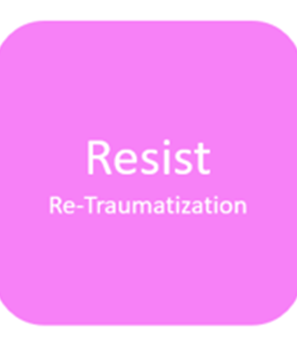
Where Compassionate Curiosity Intersects with Radical Grace

Slide 26
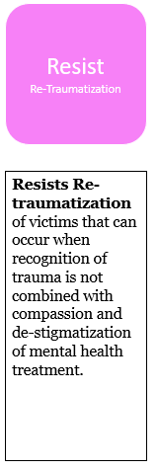
Be intentional. Without intentionality it can be easy to slip into a reactionary stance when you encounter another person’s behavior you disagree with, find difficult, or simply don’t understand.
Embrace the practice of empathic, nonjudgmental presence. Avoid big reactions. When we start with a reaction, we tend to become judgmental, which can be harmful and re-traumatizing.
Be genuine. Being genuinely curious means being open to all possibilities and ideas. It’s being in the moment with a person and not judging their story.
Be curious. It’s a shift from “what’s wrong with you?” to “What happened to you?” or “Are you ok?”
Be compassionate. Be committed to the other person’s well being and growth.
Notes:
Curiosity is a strong desire to learn something. We admit we don’t know the answer and our mind is open.
Compassion is incompatible with blame and accusation. Believe that every person wants to be known.

Slide 27
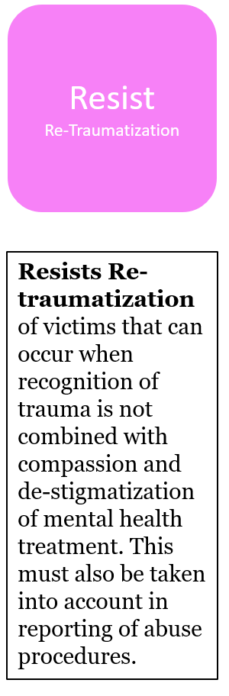
Actively listen with the goal of learning - not fixing – even if the information being delivered makes you feel like you’re hearing an uncomfortable confession.
Don’t interrupt. There is an incredible amount of vulnerability when someone shares their story with you.
Watch your body language. If someone is sharing a part of their story with you, honor that. Be present.
Avoid advice giving and be discerning about when to pull in the Word of God.
It’s ok to feel out of your element and not have the answers! Call in the experts! Build relationships with therapists and agencies you can refer to.

Slide 28

Neutralizing Shame

Slide 29
Shame is hard to explain. All I can do is tell you the lies shame told me and all the ways it made me feel not enough. Shame’s biggest lie was that I should have been “man enough” to beat the depression. The second lie shame told me is that if I were just Christian enough, God would heal my anxiety.
Steve Austin, Hiding in the Pews: Shining the Light on Mental Illness in the Church

Slide 30
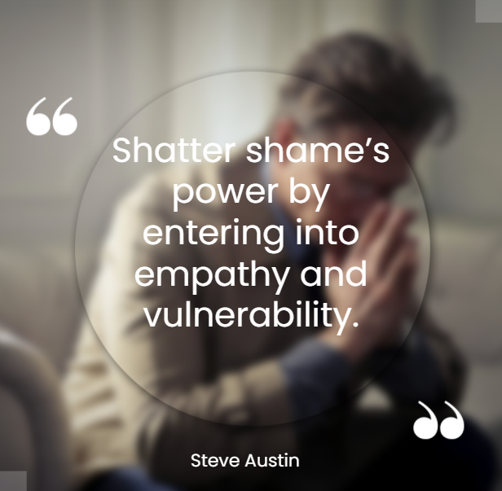
Notes:
To be vulnerable and really be an instrument that can shatter shame, we have to work on ourselves to. We have to be able to say to ourselves that it’s ok to NOT be ok.
Challenge: learn more about yourself so that your vulnerability translates into shame shattering compassion.

Slide 31
Polling Question:
What are the 4 R’s of Trauma Informed Care?

Slide 32


Slide 33
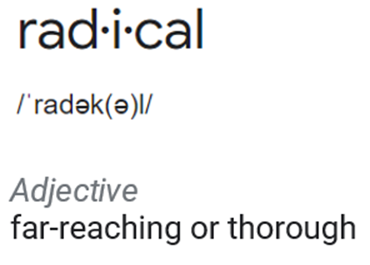
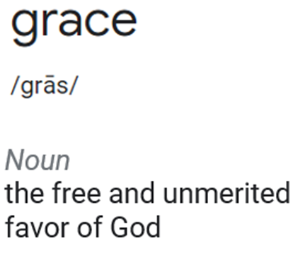

Slide 34
“While everyone desperately needs it, grace is not about us. Grace is fundamentally a word about God: his un-coerced initiative and pervasive, extravagant demonstrations of care and favor.”
– Justin Holcomb, Christianity.com

Slide 35
Self-Care
Helpers are often prone to Secondary Traumatic Stress. Secondary traumatic stress is the emotional duress that results when an individual hears about the firsthand trauma experiences of another. Its symptoms mimic those of post-traumatic stress disorder (PTSD).
Be aware of the risks.
Have good boundaries.
Seek your own support.
What is life-giving for you? Know the answer to this and even allow for accountability. This can provide balance.

Slide 36
Polling Question:
What concept will you take with you today?

Slide 37
Contact Information
Missy Blackmer
melissa.blackmer@parkview.com
missy@blackmercoaching.com
260-247-8288

Slide 38
Presentation Resources
https://www.apa.org/topics/trauma/stress
https://www.ncbi.nlm.nih.gov/pmc/articles/PMC3710585/
https://ncsacw.acf.hhs.gov/userfiles/files/SAMHSA_Trauma.pdf
https://services.viu.ca/counselling/compassionate-curiosity#:~:text=People%20often%20say%20to%20themselves,'t%20be%20this%20way!%E2%80%9D
https://ca.ctrinstitute.com/blog/the-power-of-shifting-judgement-to-curiosity/
https://www.thenationalcouncil.org/wp-content/uploads/2013/05/Trauma-infographic.pdf?daf=375ateTbd56
https://stopasuicide.org/
https://www.christianity.com/theology/what-is-grace.html
Austin, Steve. (2021). Hiding in the Pews: Shining the Light on Mental Illness in the Church. Fortress Press.
https://trcutah.org/faith-leaders
https://www.nctsn.org/trauma-informed-care/secondary-traumatic-stress/nctsn-resources
https://www.soulshepherding.org/vicarious-trauma-in-ministry/
https://www.acesaware.org/resources/
List of ACEs related resources for churches - http://www.intermountainministry.org/wp-content/uploads/2012/11/List-of-Resources-for-Churches-interested-in-learning-more-about-ACEs.pdf
https://acestoohigh.com/aces-101/
https://www.traumainformedchurches.org/resources-to-equip

Slide 39
The 4 R’s of Trauma Informed Church
Realize
Recognize
Respond
Resist
Re-Traumatization
Realizes the widespread impact of trauma on those in your church and your community
Recognizes the signs and symptoms of trauma in people of all ages as well as the impact on a person living with a traumatized family member.
Responds to the needs of its congregation and community by integrating knowledge of trauma into the planning of ministries, policies, and stewardship of the church's resources
Resists Re-traumatization of victims that can occur when recognition of trauma is not combined with compassion and de-stigmatization of mental health treatment.
Inspired by SAMHSA and https://www.traumainformedmd.com/churches.html

