Slide 1

Substance Use Disorder
How Communities of Faith Can Best Walk Alongside Individuals and Families on Their Recovery Journey

Slide 2

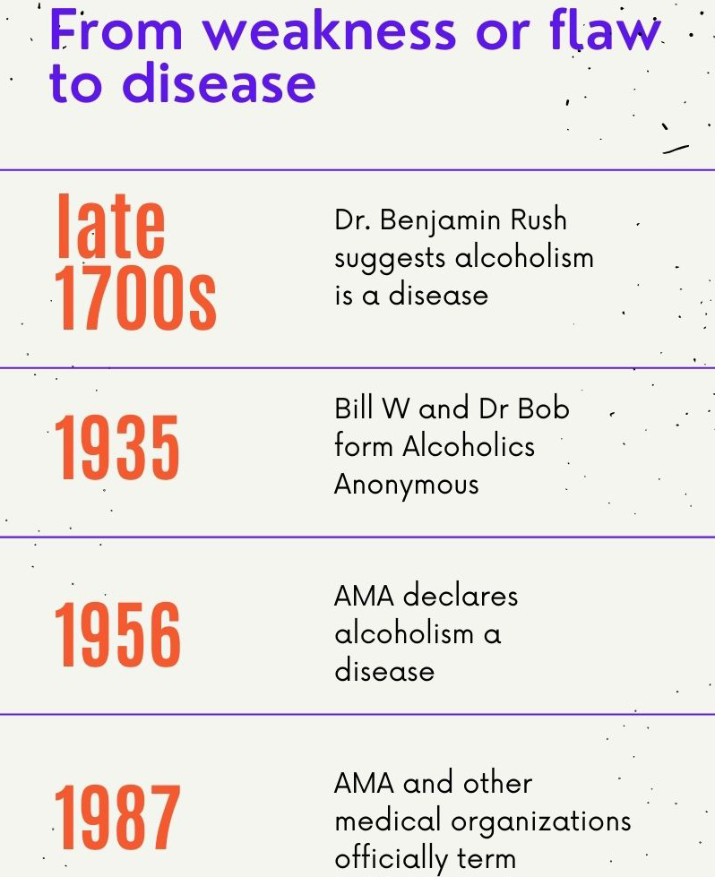
According to the Partnership to End Addiction or drugfree.org:
Addiction, clinically referred to as a substance use disorder, is a complex disease of the brain and body that involves compulsive use of one or more substances despite serious health and social consequences. Addiction disrupts regions of the brain that are responsible for reward, motivation, learning, judgment, and memory.

Slide 3
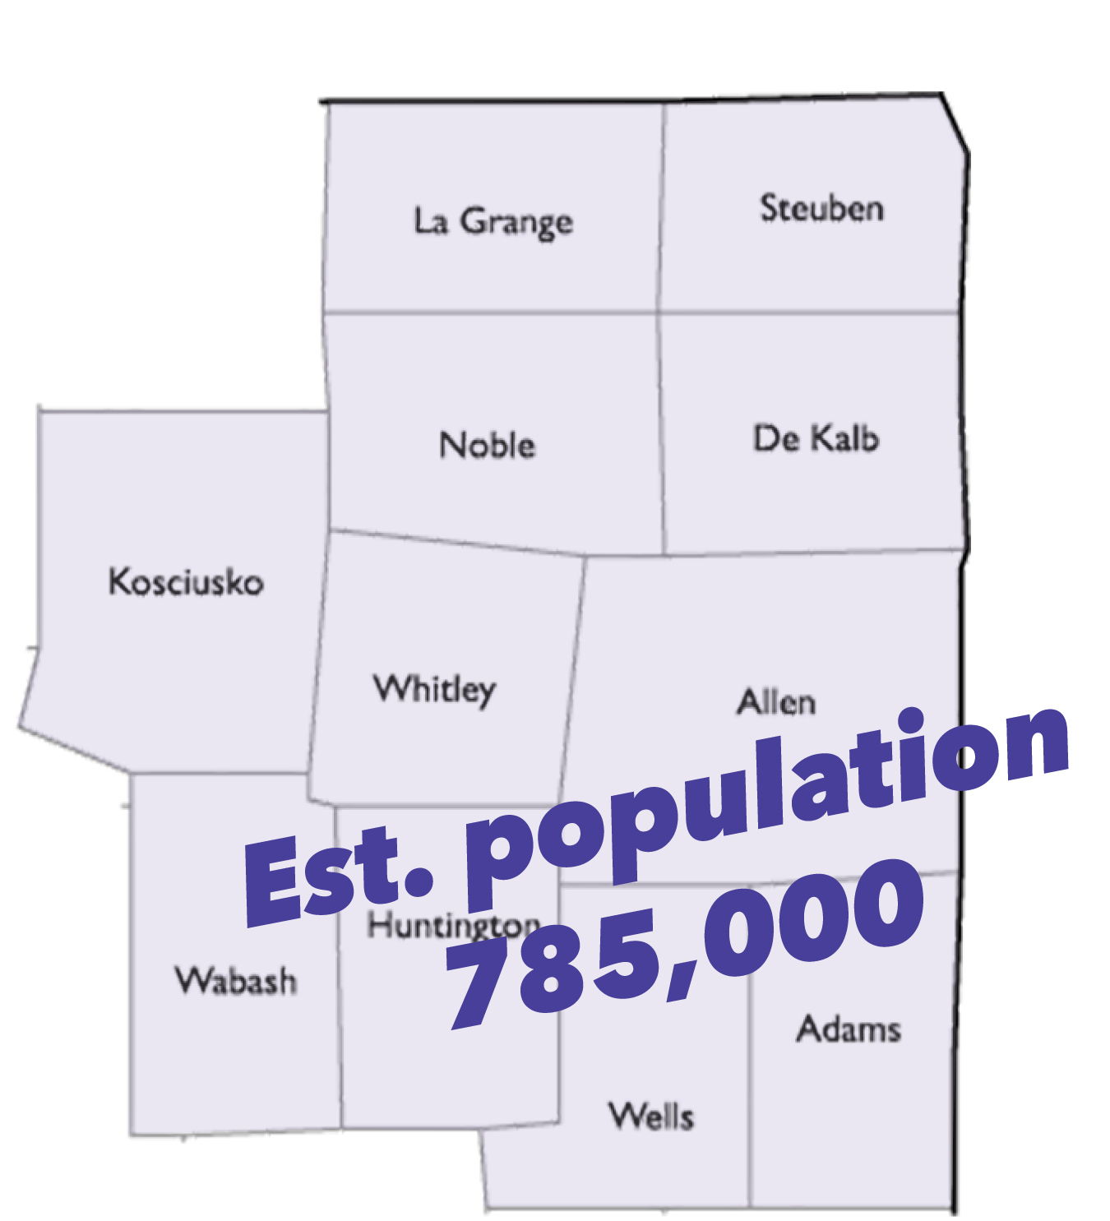
~ 86% of the population is over age 12, so 675,000
1 in 10 addicted to at least one substance = 67,500 individuals battling substance use disorder in NE IN
Conservative estimate of 4 family members affected each = over 250,000 family members Plus the 67,500 = well over 300,000 RIGHT HERE

Slide 4
Faith in Recovery
“You may be surprised to know how common faith-based recovery programs are. According to a 2019 article in the Journal of Religion and Health, 73% of addiction treatment programs in the United States involve some aspect of spirituality. This includes most 12-step programs like Alcoholics Anonymous (AA), whose recovery plan is based on spiritual principles.”
“Faith-based recovery programs provide many therapeutic benefits.”
“Importantly, there is evidence that faith can positively impact addiction recovery.”
Source, WebMD

Slide 5
Faith in Recovery
“The findings are similar to previous studies that show people recovering from substance abuse tend to place great importance on prayer, belief in a God and a strong sense of faith. The findings are also similar to the result of studies examining the relationship between religion and mental health with other populations. Those studies reported increased coping skills and greater resilience to stress and overall life satisfaction.”
Source, American Psychological Association, study by Pardini and Plante

Slide 6
Stigma
Stigma: a mark of disgrace associated with a particular circumstance, quality or person
STIGMA = STEROTYPING - PREJUDICE - DISCRIMINATION

Slide 7
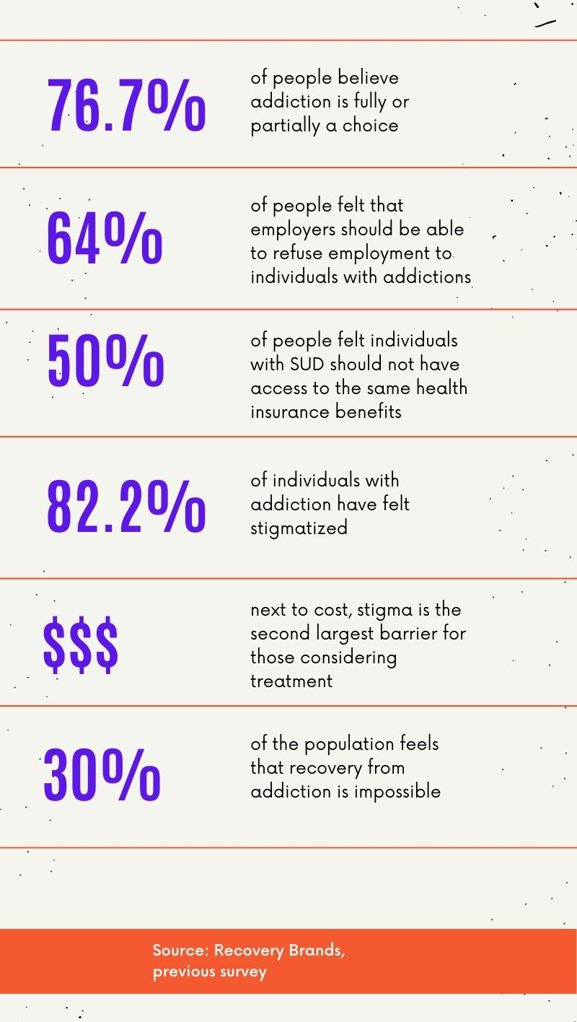

Slide 8
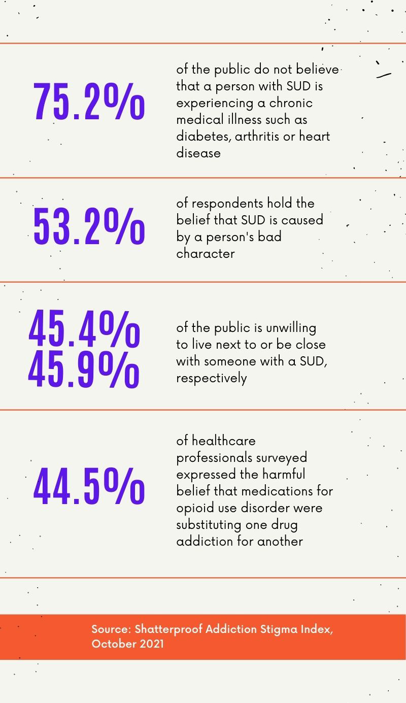

Slide 9
How can congregations be supportive?
³⁶ “Teacher, which is the greatest commandment in the Law?”
³⁷ Jesus replied: “‘Love the Lord your God with all your heart and with all your soul and with all your mind.’^{[a]} ³⁸ This is the first and greatest commandment. ³⁹ And the second is like it: ‘Love your neighbor as yourself.’
Matthew 22:36-40

Slide 10
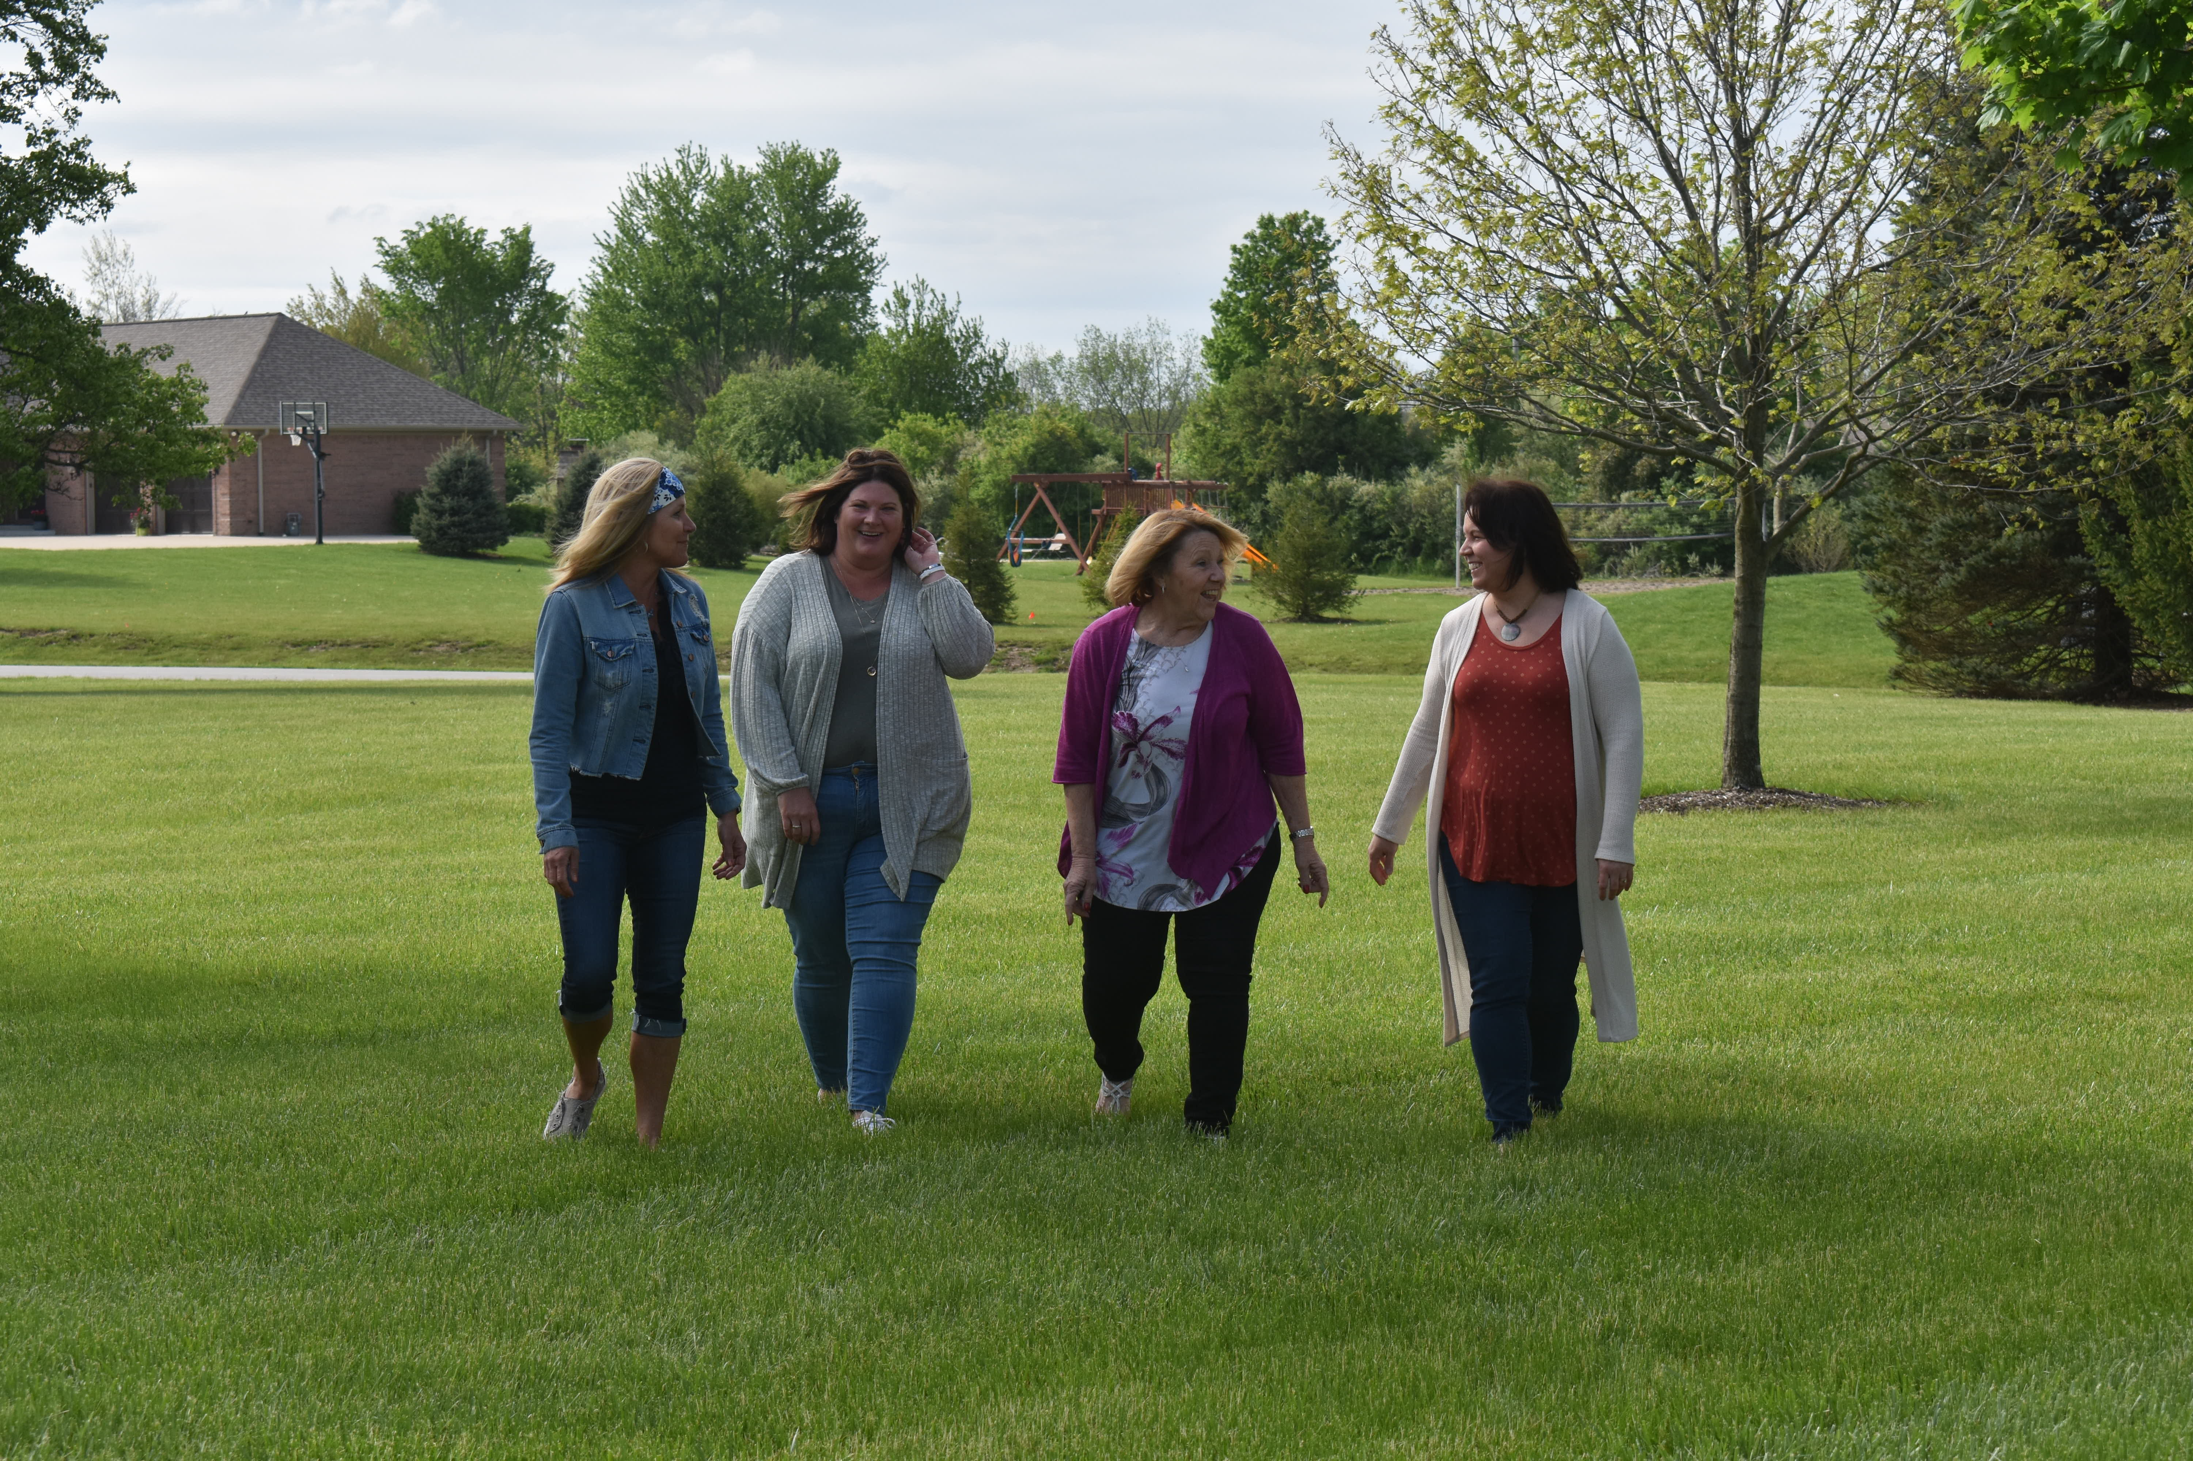
First meeting held June 18, 2019

Slide 11
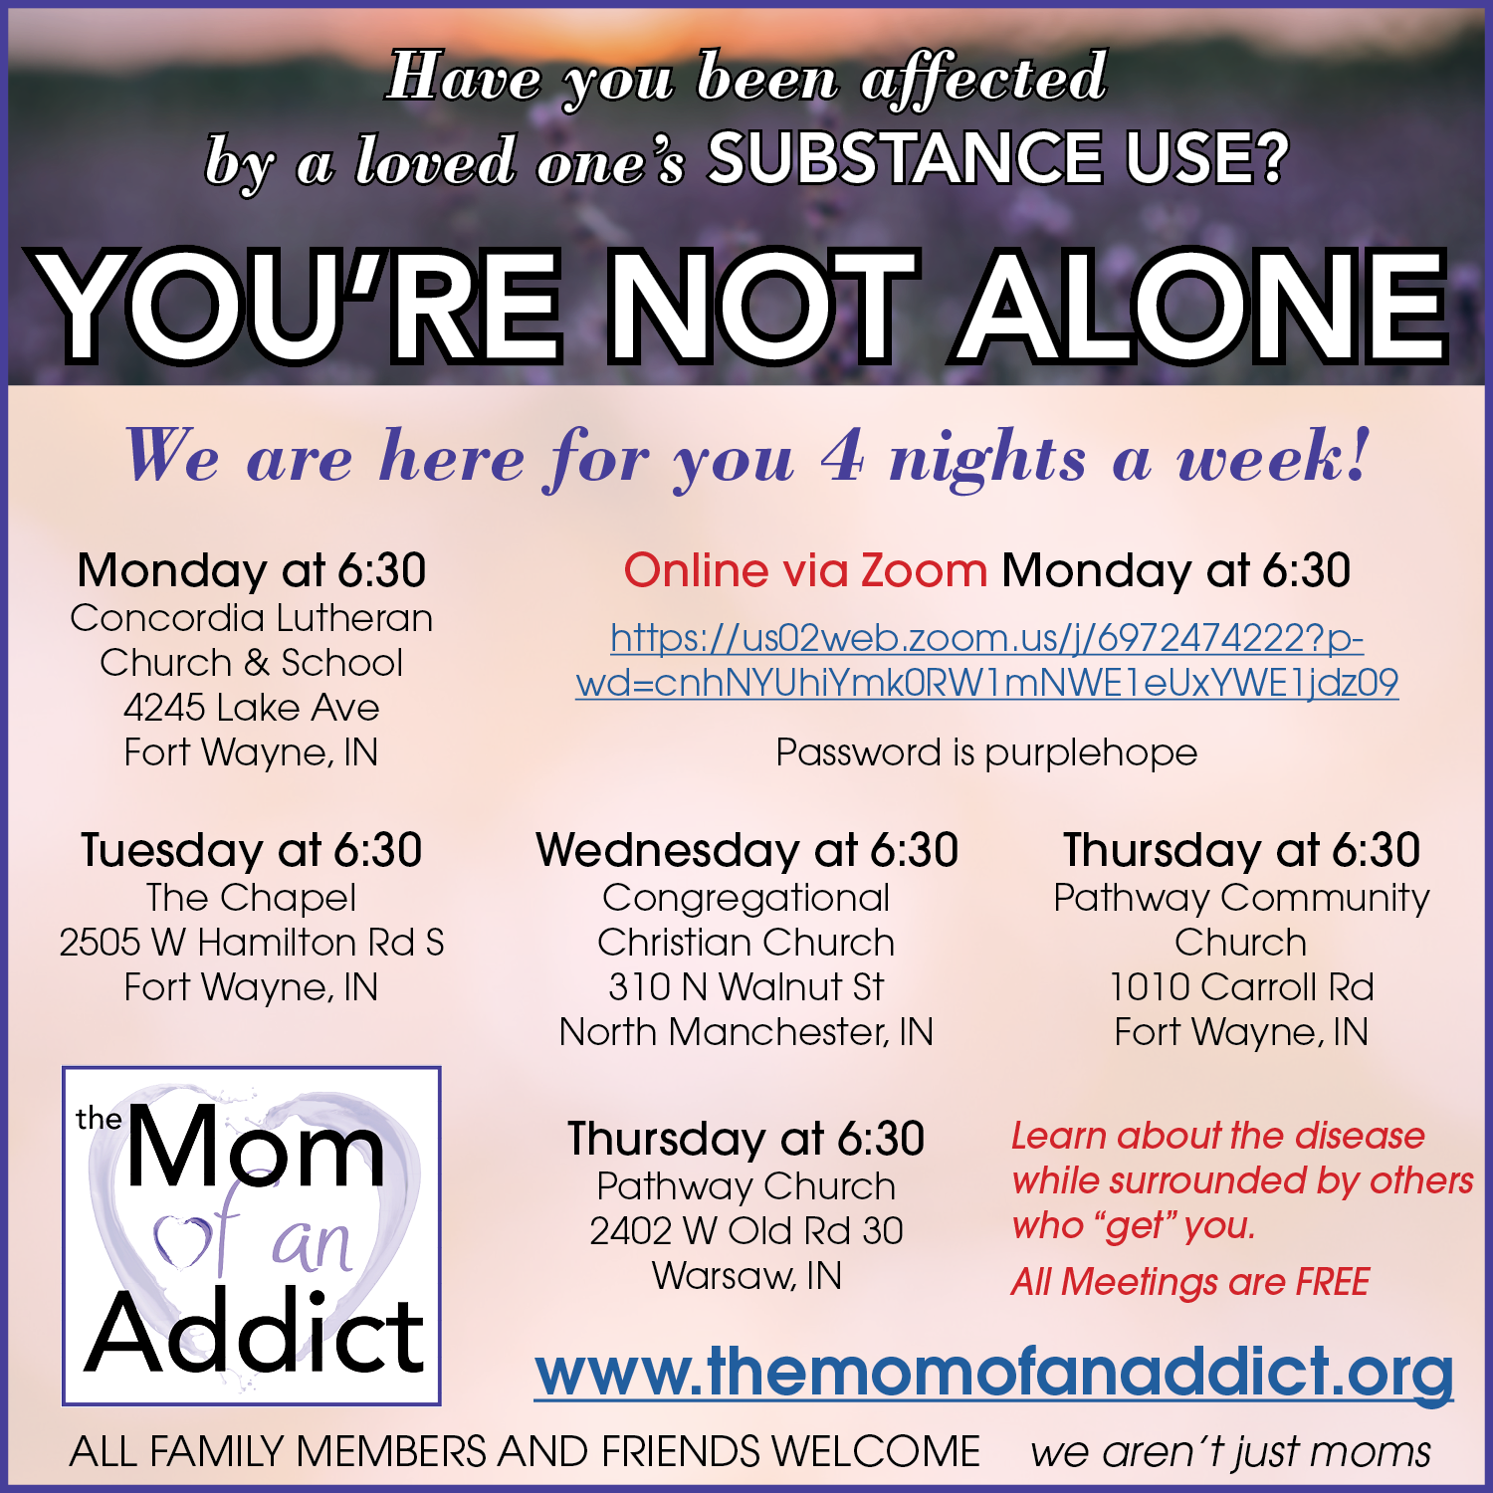

Slide 12
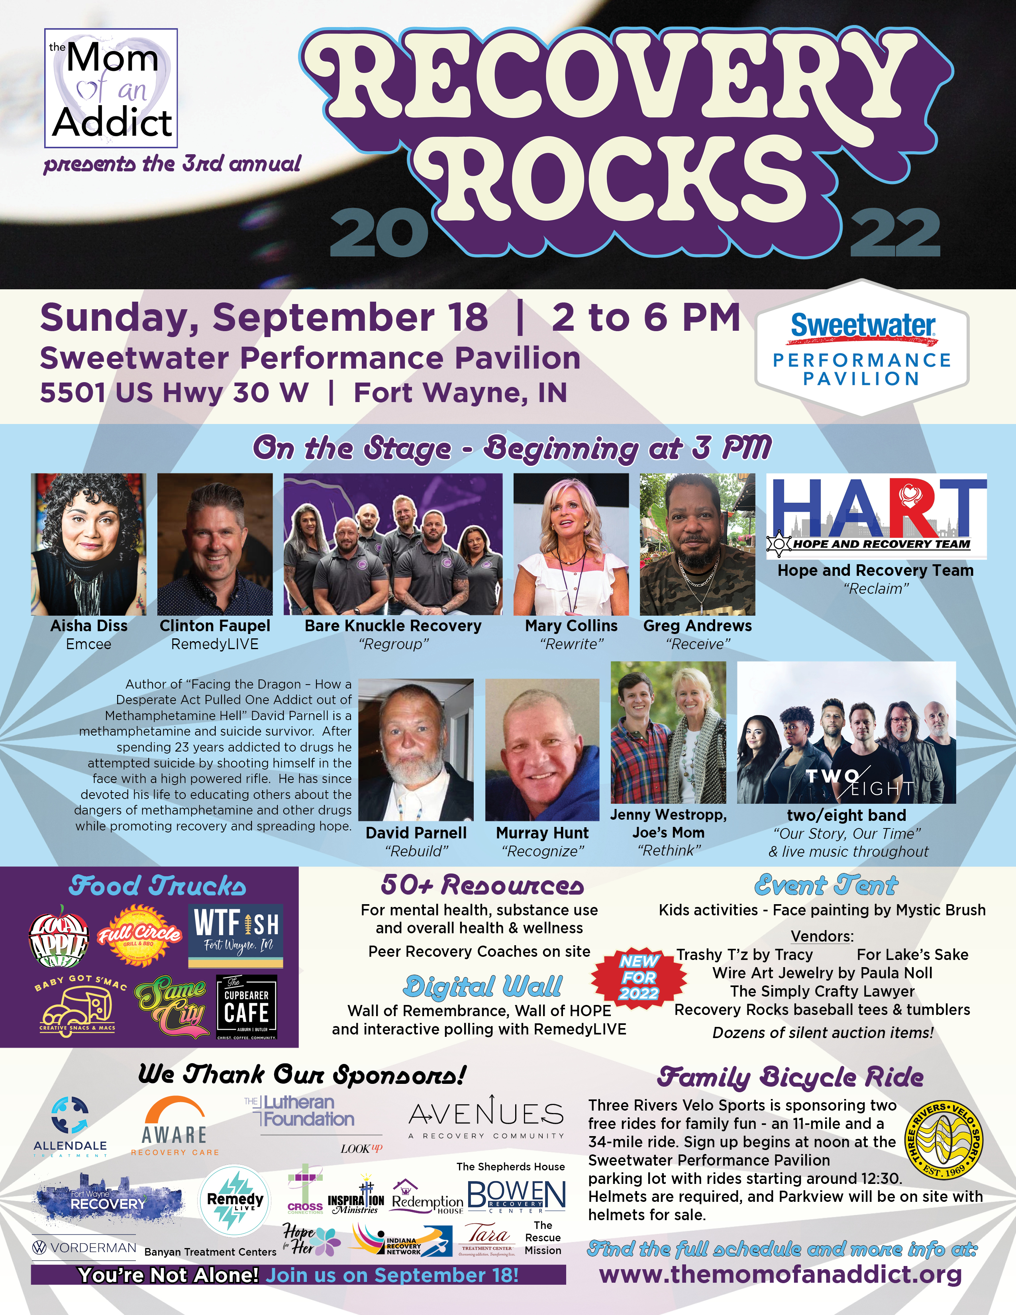

Slide 13
www.themomofanaddict.org
donna@themomofanaddict.org
jen@themomofanaddict.org
260-209-4686

