Slide 1



The Church’s Care at Life’s End:
Wrapping the dying and their loved ones in care that supports emotional, physical and spiritual wellbeing

Slide 2
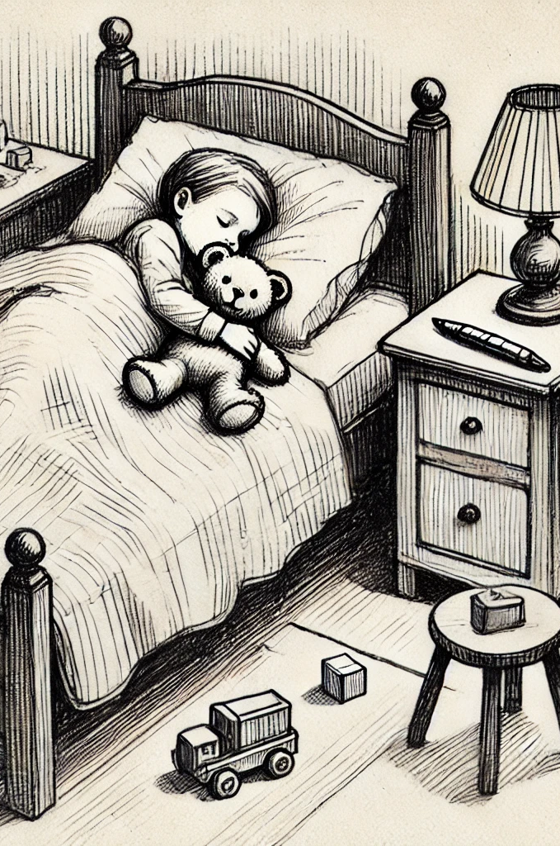
In peace I will both lie down and sleep;
for You alone, O lord, make me dwell in safety.
When we are about to go to bed and take off our clothes, we should think about how at sometime the clothing of our body will be taken off.
When we lay ourselves down to sleep, we should think about how someday, we will be placed in a grave as our bed.
When we close our eyes, we should think about how someday our eyes will close to death.
When we get up out of bed, we should think about how someday after our death we will rise from our graves.
If we would daily meditate on our death in this way, we can one day die a godly and peaceful death. - Johann Gerhard 1621

Slide 3
We must all die … 2 Samuel 14:14
100% of us have or will have a loved one or close friend die.
100% of us will face our own death.
1 in 20 children will lose a parent by the time he or she graduates from high school Source: Grief in the Classroom, January 13, 2015, NPR ED

Slide 4

In our churches today …
Over half (54%) of active adult church members are 60 years old or older Apr 4, 2023 2020 PRRI Census of American Religion

Slide 5
29% of the U.S. population provide care for a chronically ill, disabled or aged family member or friend during any given year and spend an average of 20 hours a week providing care for their loved one.
Source: Caregiver Action Network

Slide 6
Who are the caregivers?
Approximately 66% of family caregivers are women. More than 37% have children or grandchildren under 18 years old living with them.
1.4 million children ages 8 to 18 provide care for an adult relative; 72% are caring for a parent or grandparent; and 64% live in the same household as their care recipient.
Many sit in your pews.

Slide 7

40% to 70% of family caregivers have clinically significant symptoms of depression with approximately a quarter to half of these caregivers meet the diagnostic criteria for major depression. Zarit, S. (2006). Assessment of Family Caregivers: A Research Perspective
77% of people with a terminal illness are believed to suffer depression. _{Baylor University}
Loneliness was perceived by professionals as highly prevalent for people with a terminal illness (92.6%) and their carers (86.8%).
Social support was viewed as central towards alleviating feelings of loneliness and promoting connectedness at end of life. Caregivers: A Research Perspective

Slide 8
Other emotions as death approaches . . .
Grief
Grief
Anxiety
Anger
Resentment
Fear
Sadness
Relief
Calm
Acceptance
Regret

Slide 9
In our modern Western society, when death approaches, we‘ve been trained to believe the the family needs privacy and space.
We feel better if we can get things back to normal as fast as possible.
Tears and open grief make us uncomfortable.
Death in our culture is an encroachment on life instead of part of life.
The result is that many people ill­-equipped to deal with death.
And many, face death alone or with a very small circle of support.

Slide 10
How can the Church care for the Dying and their caregivers?

Slide 11
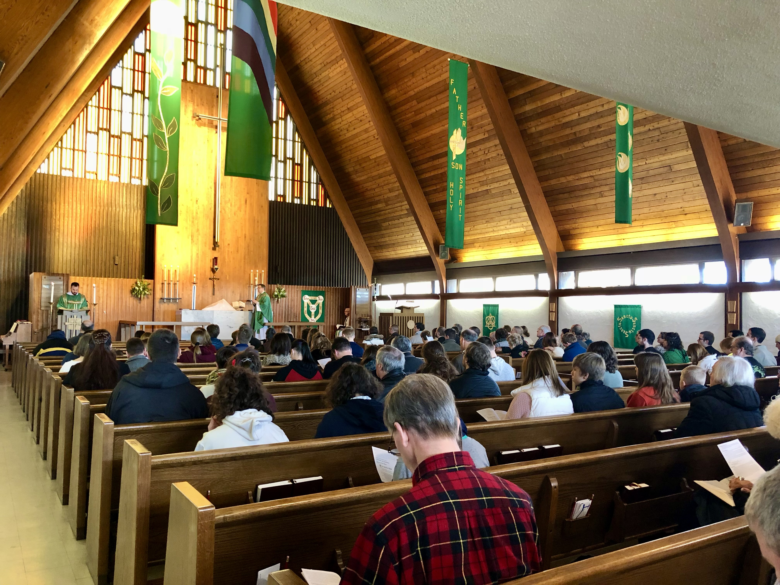
How can the Church care for the dying and their caregivers?

Slide 12

PRAY
Listen
Be Present
Observe
Help

Slide 13
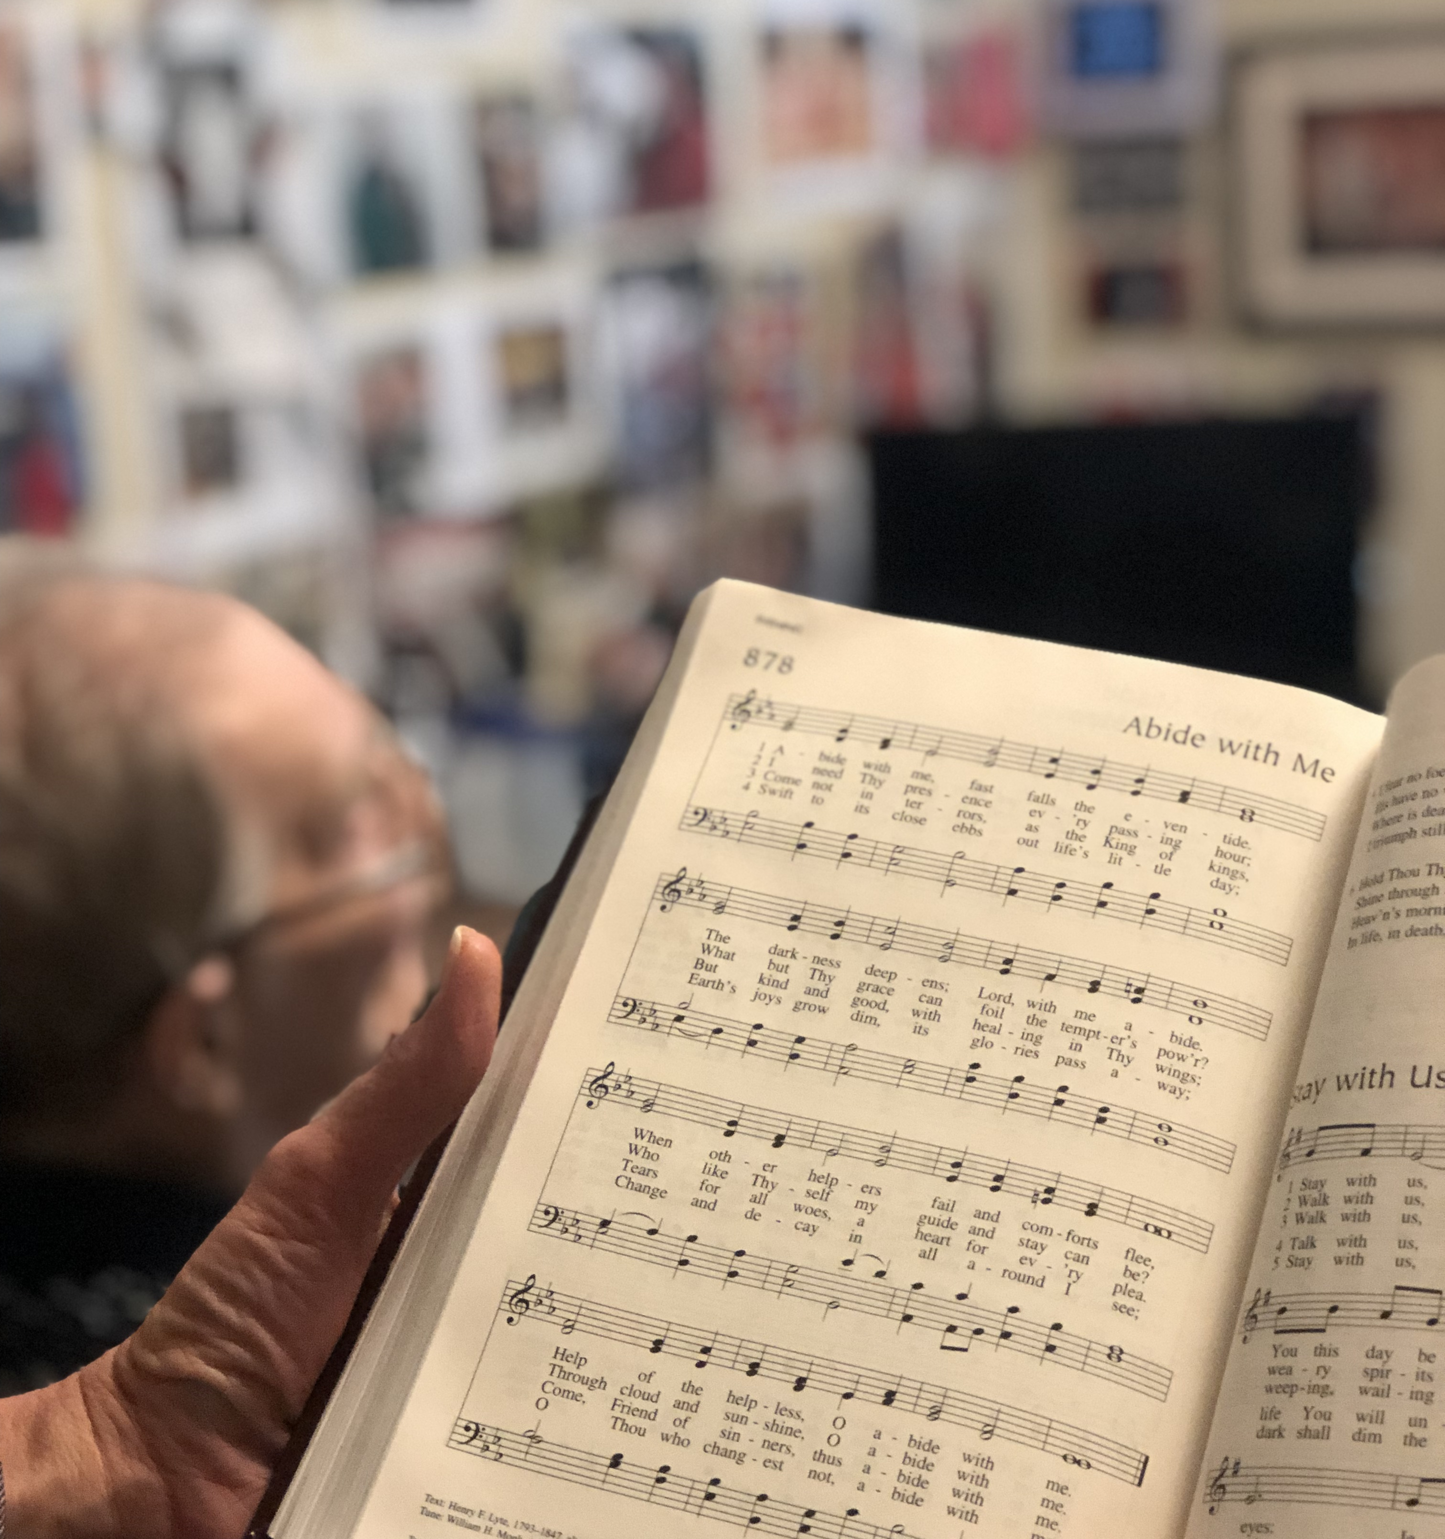
Before
During
After
Long After

Slide 14

Pastors
Congregations
Individuals

Slide 15


Save the date!
A Forum on the Church’s Care at Life’s End
July 7-9, 2025

Slide 16

Let’s keep talking! pamjniel@aol.com

Slide 17

Today’s Trivia Winners Will Receive a Copy of:
Whether you have lost a job, a dream, a friendship, or a loved one, you mourn. You might mourn for a few weeks, or your grief may extend for years. Sadness seems to build a permanent residence in your bones, weighing down your soul. You wonder if you’ll ever feel whole again. Then God plunges into your heartbreak and works abiding and holy transformation in your life. It may take months or years for you to heal, but you can ground your hope for healing in Jesus. He will always be your hope when your heart breaks. Let this book be a place of refuge and a point of reference as you navigate the path of grief.

Slide 18
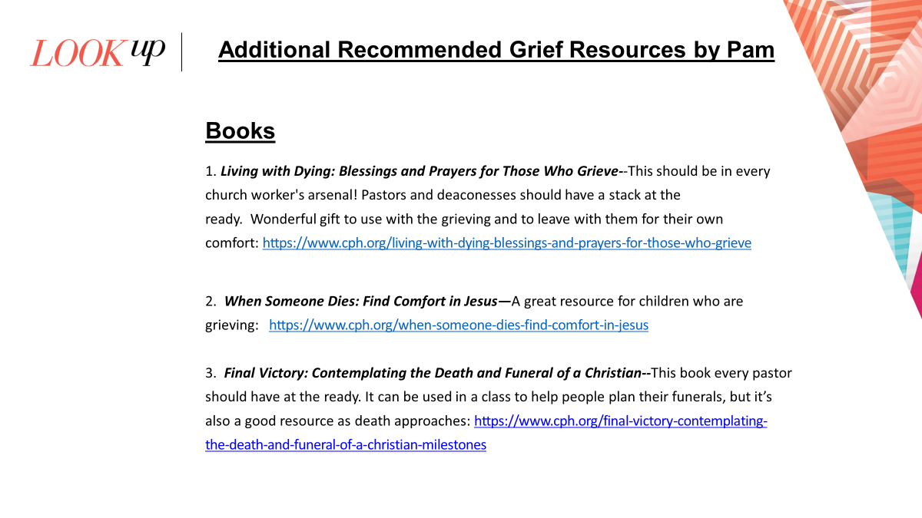
Additional Recommended Grief Resources by Pam
Books
1.
1. Living with Dying: Blessings and Prayers for Those Who Grieve--This should be in every church worker's arsenal! Pastorse in every church worker's arsenal! Pastors and deaconesses should have a stack at the ready. Wonderful

Slide 19
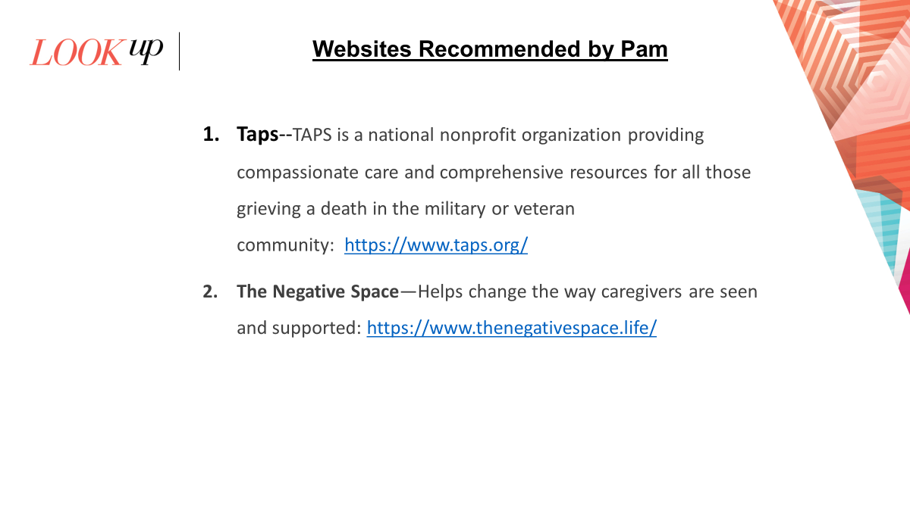

Slide 20
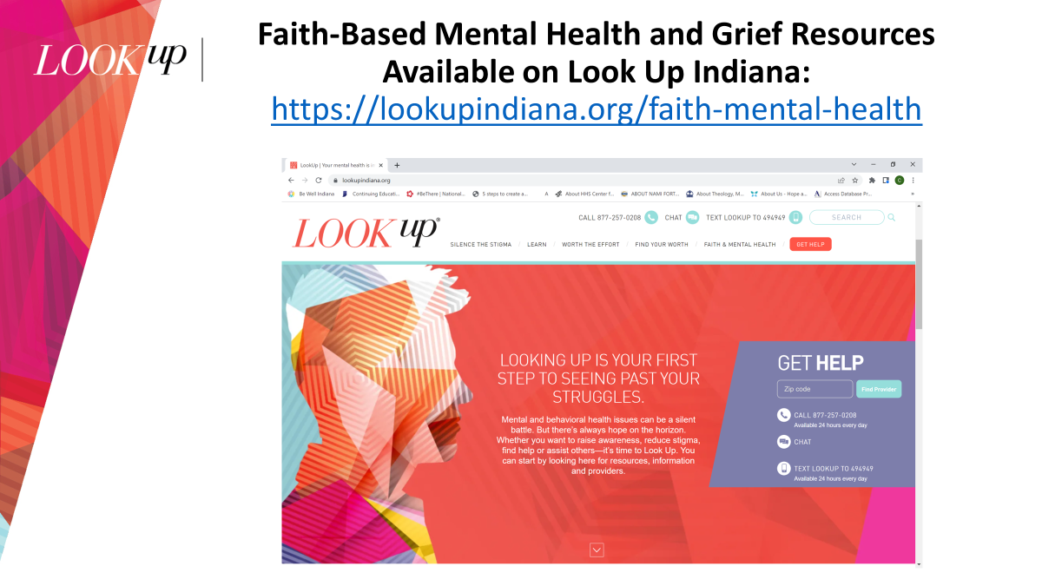

Slide 21


Slide 22


