Slide 1
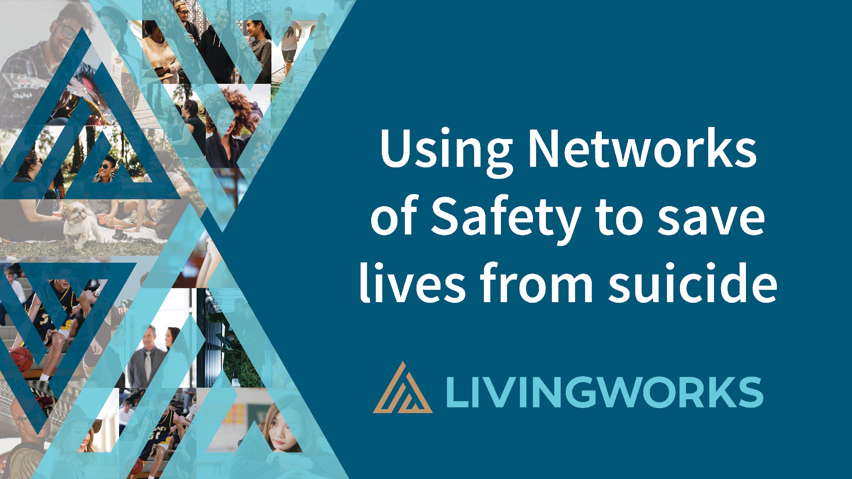

The Lutheran Foundation
Suicide Prevention and the Local Church: How Churches can help
Glen Bloomstrom,
Director, Faith Community Engagement

Slide 2


Why are we here today?
Suicide is a major societal issue
Many are impacted
The Pandemic has increased suicide concerns
Suicidal thoughts and behaviors are in churches
This webinar will
contextualize suicide in ministry settings
present ways to prepare and better serve your community
Notes:
TEgan

Slide 3
Workshop Agenda
The Big Picture - Statistics
Causes Triggers and Contributors to suicide
Definitions
Why Ministry Leaders
The challenge of suicide stigma
Barriers and ways to address suicide and encourage help seeking
Ways ministry leaders can prepare to help
Notes:
TEgan

Slide 4

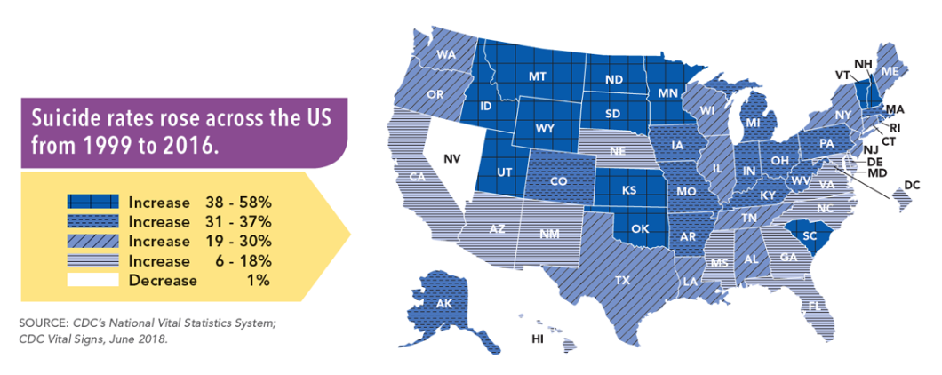
Big Picture: Suicide rising across the US

Slide 5
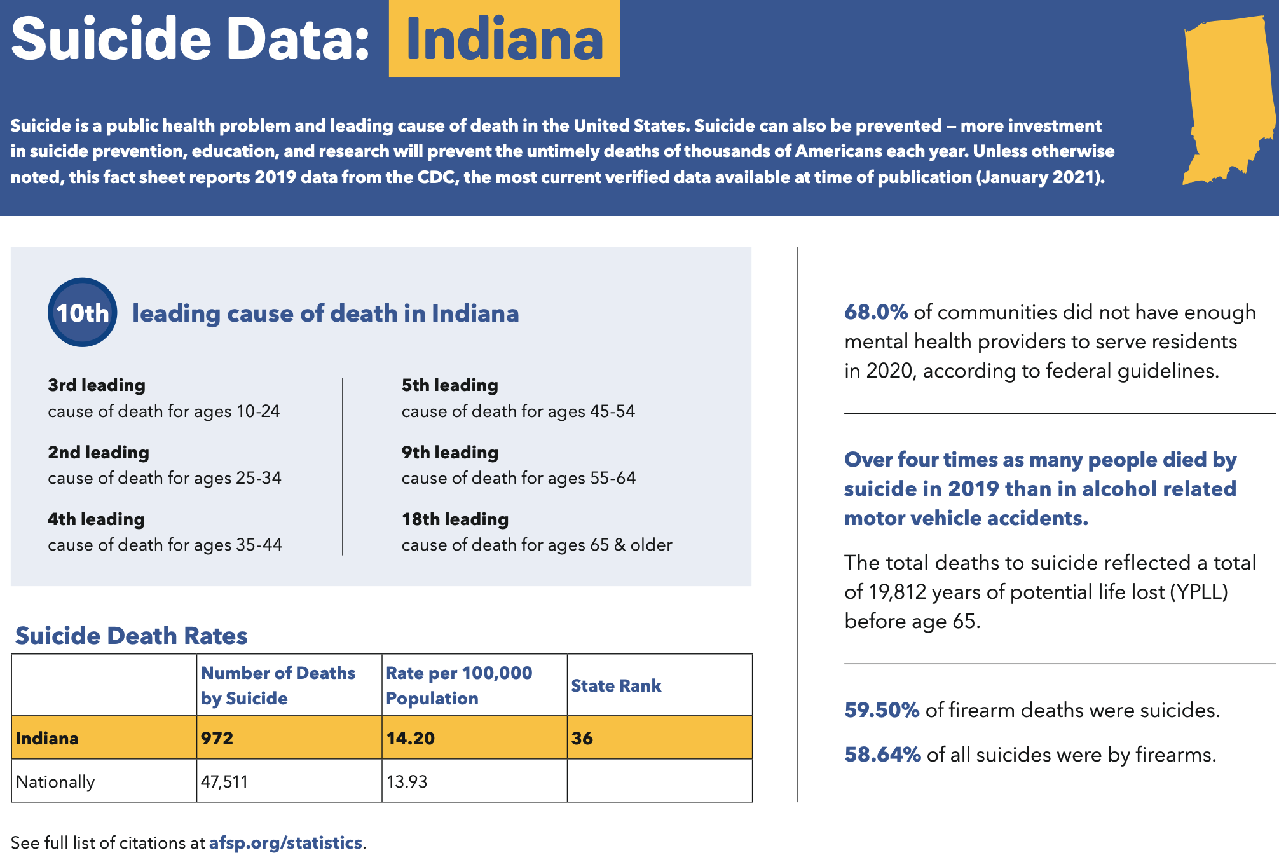

Slide 6
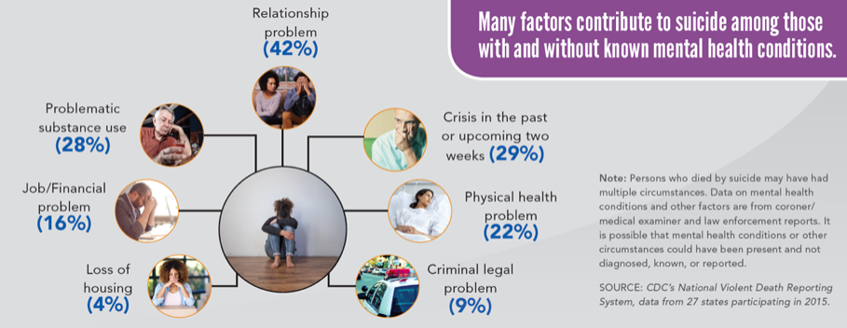
Causes, Triggers and Contributors

Slide 7
Polling Questions
Have you known someone (personally or professionally) who has died by suicide? Yes / No
Have you supported someone after having suicide thoughts or behaviors? Yes / No
On a scale of zero to 5, how prepared did you feel in providing ministry support to them? (scale 0-5)
Notes:
TEgan

Slide 8
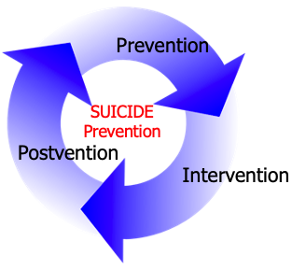
Definitions: What is Suicide Prevention?
Clergy are viewed as a source of help
Clergy say that people seek their help
Faith leaders engage suicide broadly
People of faith play a vital role in
safety from suicide
Notes:
TEgan

Slide 9
Definitions: what is Suicide and who are Survivors?
Suicidal thoughts: thoughts & ruminations about taking one’s life.
Suicide attempts: person engages in behavior that involves a deliberate attempt to take one’s own life
  Not the same as cutting goal is NOT to end one’s life
Suicide death: Self initiated action that results in death
Survivor: One who survived an attempt (lived experience), or loved ones or friends with a relationship left after a death by suicide
Notes:
TEgan

Slide 10

The Impact of a Suicide Death
135 People Exposed
Approximately 36.1% of people exposed are “close” or “highly close” n=48
Not just “first degree” relatives
(Cerel, Brown, Maple, Bush, van de Venne, Moore and Flaherty, 2018)

Slide 11
Why Ministry Leaders?
Size
Influence
Involvement
Access
Little Training 2/3 less than 5 hours; 1/3 have 0 hours
  Uncertain it is their role
  Struggle with stigma around suicide
  Wrestle with faith integration
Notes:
SIZE 36% of US population worships monthly (119M)
18% worship regularly in AUS (4.5M); about 52% of the population identify as Christian
344K places of worship (N America) 13,000 (AUS)
450-600,000 Leaders (N America) 15,000+ (AUS)
81K graduates from approx 250 graduate seminaries in N America
INFLUENCE: Are often involved with postvention
A community resource
ACCESS Available, approachable, confidential and free
Little Training: Role, Stigma, Wrestle with integrating faith with MH and Suicide

Slide 12
Polling Question
How much of your ministry time do you spend each week in pastoral counseling? (0, 2, 4, more than 8 hours)
Notes:
TEgan

Slide 13
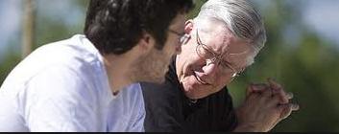
Ways Ministry Leaders are Involved
A review of 10 separate studies found clergy devote 10-20% of their workweek to counseling emotional or marital problems
Applying this percentage to 1998 Labor estimate of 353K clergy the aggregate statistic of time spent on pastoral counseling annually 138 million hours!
Notes:
TEgan

Slide 14
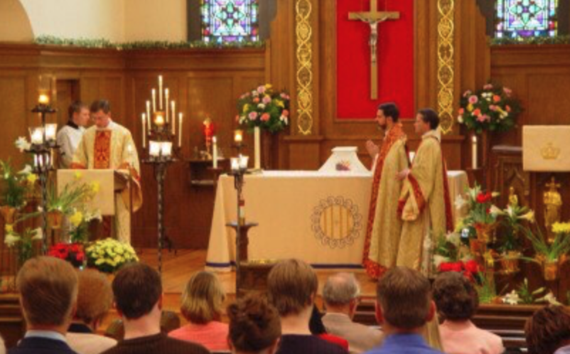
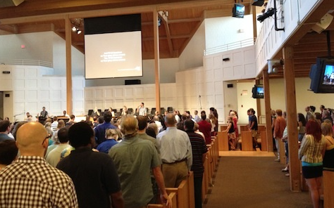
Ministry Leaders… Congregational Perceptions
How are they viewed by their congregants / members?
  “Front line helpers” for life concerns (mental health and suicidal thoughts)
  Offering religious and spiritually integrated support
  Performing funerals / memorials following suicide deaths
  Providing ongoing religious and spiritual support for survivors
Notes:
Postevention strong evidence of helping effects for most

Slide 15
The Problem – a lack of training and stigma
Ministry Leaders have little to no suicide prevention training
  One third 0 training, half have less than 5 hours
Few graduate programs offer suicide prevention training
Most training is on the job or through continuing education
People of faith assume their leaders are trained and are disappointed
Besides a lack of training…. the primary problem in most ministry settings is suicide Stigma
Notes:
One in 3 have no training
Half report 5 hours or less
More training predicted more interventions and more competent response
The greater # hours of intervention training hours predicted the #’s of intervention provided
Most M.Div. Courses have 1 class in counseling

Slide 16
Polling Question
Did you have any training in suicide prevention in your ministry training / preparation? Yes / No
How many hours of training have you had that were specifically focused on suicide prevention, intervention and long-term (post suicide) support? 0, 2, 4 hours, 8 hours
Notes:
TEgan

Slide 17
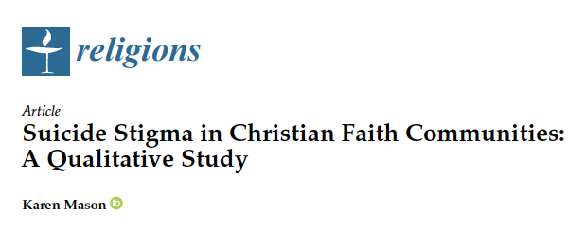
Our greatest safety from suicide challenge:
Stigma
Notes:
Mason, Karen. 2021.
Suicide Stigma in Christian Faith Communities: A Qualitative Study.
Religions 12: 540. https://doi.org/10.3390/rel12070540

Slide 18

What is suicide Stigma
Stigma is a mark of disgrace that sets a person apart from others. When a person is labeled by their illness they are no longer seen as an individual but as part of a stereotyped group. Negative attitudes and beliefs toward this group create prejudice which leads to negative actions and discrimination.
Stigma = stereotyping -> prejudice -> discrimination
Notes:
TEgan

Slide 19
Barriers to addressing suicide stigma
Silence
Ignorance (about mental health or theology)
Expectation of having it all together
Expectations about “the preaching moment”
Being busy
An artificial division between mental health/suicide and faith
The lack of training for faith leaders
Notes:
TEgan

Slide 20
Ways to address stigma in church
Talk about suicide
Address skill deficits – implement a network of safety
Practice vulnerability – share your stories
Address the theology of suicide (suffering) – preach
Appreciate that faith communities have a unique contribution
Get ministry leader leadership on board
Address cultural / systemic issues
Notes:
TEgan

Slide 21
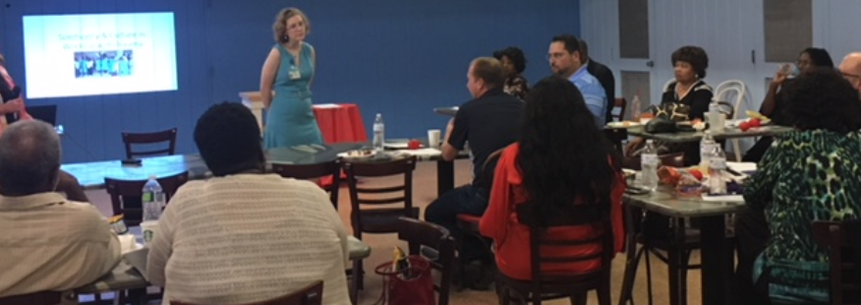
What to train and who to train?
Notes:
TEgan

Slide 22
Introducing LivingWorks
World leaders in suicide prevention training
Standard for crisis line training
Programs used in a variety of settings: schools, military, Law Enforcement, and many more
Over 2.3 million trained since 1983
Programs are designed for all audiences
Now there is a new program to train Ministry Leaders: LivingWorks Faith
Notes:
TEgan

Slide 23

A promising competency-based program:
LivingWorks Faith
Notes:
Tegan

Slide 24

Suicide Prevention Competencies for Faith Leaders
Developed in conjunction with Action Alliance
Uses:
  Curriculum Development
  Training Approaches
  Evaluate Current Resources
  Identify Needed Resources
Notes:
Glen

Slide 25

Overview
5-6 hour online training for Christian ministry leaders – $149.95 per license
Self-paced, ongoing access to resources
Covers attitudes, theology, suicide prevention, intervention, and postvention
Interactive training with practice – LivingWorks Start
Narrative approach with video stories of leaders and survivors
Learners pdf Companion Guide
Notes:
Tegan

Slide 26

LivingWorks Faith: Course Content
Self-paced online learning modules:
Introduction
Understanding suicide in the context of faith
The role of faith leaders
Promote life
Intervene
Provide support after a loss
Put your learning into practice
Conclusion, resources, and references
Notes:
Tegan
Talk about how it is designed to either flow through or just be accessible for the most-pressing content right now.
Simulations
Narrative stories being used
Wide range of resources and activities provided

Slide 27
Course Outcomes and Benefits
Understand ministry leaders’ role in keeping communities safe
See how culture, attitudes, and theology impact our actions
Demonstrate the skills and strategies for faith leadership in suicide prevention, intervention, and postvention
Gain increased confidence, readiness, and hope
Reduce fear and anxiety around suicide prevention
And most importantly…
Save lives and inspire others to do so as well
Notes:
Tegan
This is just the beginning. We have focused on Christian faith leaders in the first instance but intend to be able to expand our offerings to apply similar core suicide prevention, intervention and postvention teaching in a way that is applicable and relevant to other groups of faith and religious leaders in a way that is cohesive with their practices, theology and cultures.

Slide 28
Application Examples
Seminary Continuing Education
online self paced with 4 - 90 min facilitation sessions over one month
Seminary Graduate M.Div. Integrated into counseling course
online self paced with a 2-hour class discussion
State Community Zero Suicide grant funded Faith Leader Outreach
online self paced with 4 - 90 min facilitation sessions over one month (3 cohorts of 40 participants)
Goal: faith network engagement and development.
Followed by face-to-face Network of Safety training
Notes:
Glen

Slide 29
Data Trends n200+
Confirmed that MLs have little to no training
  Facilitation helps to complete the content and build community
  Online self paced was useful for busy MLs – some preferred online only
  Video testimonials are appreciated and “make it real.”
Learners feel confident to intervene after completing LivingWorks Start
Content builds on or builds interest in face-to-face training
Notes:
Glen

Slide 30
Testimonials
“…I highly recommend that all pastors, ministers, and others take this course to have a better understanding of suicide.”
“Absolutely worthwhile training. It took me from having zero experience and confidence in how to deal with suicide prevention, intervention and postvention to a very confident level dealing with this topic... I feel so much more equipped!”
Notes:
Tegan

Slide 31

What a Faith Community Network of Safety Looks Like
Senior
Ministry
Leader
Associate Ministry
Leaders
Natural
Helpers and Volunteers
All
Interested Members
Establish a culture of hope, openness, and support – ready to help with intervention skills
LivingWorks Faith
LivingWorks ASIST
Uphold culture and be ready to help with intervention skills
LivingWorks Faith
LivingWorks ASIST
Recognize when someone needs help and connect them for an intervention
LivingWorks safeTALK
Identify those in need in the congregation and community so they can get help
LivingWorks Start
Notes:
Tegan

Slide 32
Trivia Questions - Quiz
What are the parts of Suicide Prevention? (1) Prevention only, (2) Prevention and Intervention, or (3) Prevention, Intervention and Postvention
On average how many people are exposed to each suicide death?
(20, 40, 100, 130+)
Of that number how many survivors consider themselves “close” or “very close” (6, 10, 25, 40+)
Notes:
TEgan

Slide 33
Ready to Get Started? … What’s Next?
Here are next 4 steps:
  You will receive email #1 with registration information from Carole Carole@thelutheranfoundation.org
  Receive an email #2 from notifications@learnupon.com with an enrollment link (we will email when to look for it)
  Set up your account with LivingWorks to start the program
Notes:
TEgan

Slide 34
Key Dates & Contact
October 11th Registration Cut Off (5:00 ET)
November 11th Complete Course and Post Course Survey
November 18th Second Webinar (12:00-1:30 ET)
Questions or Issues: Carole
  Email Carole@thelutheranfoundation.org
  Phone: 260-458-2115
Notes:
TEgan

Slide 35

Thank you
glen.bloomstrom@livingworks.net
(612)-824-1395
www.livingworks.net/faith
Notes:
Glen

