Slide 1
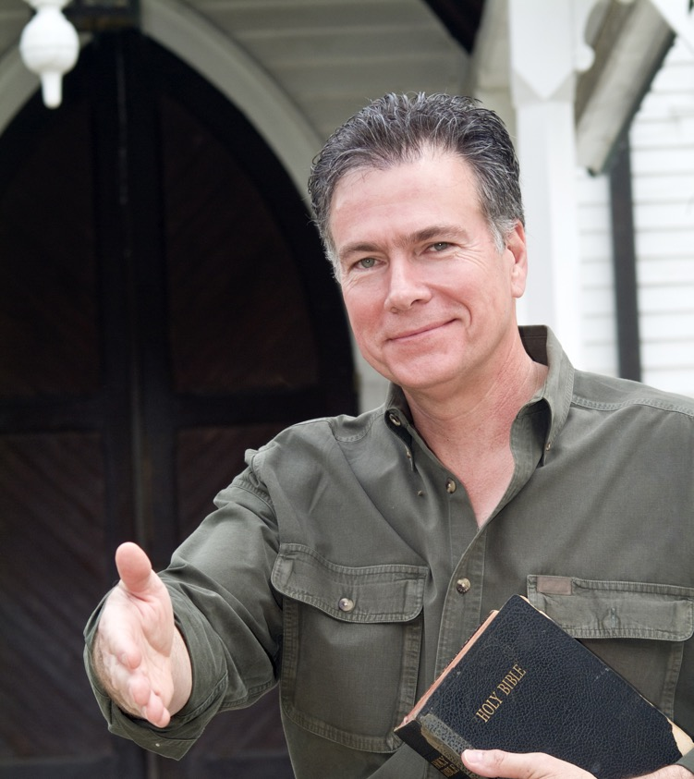
Why your church needs a mental health inclusion strategy
Stephen Grcevich, MD
President and Founder, Key Ministry
Lutheran Foundation
Fort Wayne, IN
March 30, 2021

Slide 2
Our objectives today…
Examine available research addressing the impacts of mental illness on church attendance/participation.
Recognize barriers to assimilation for children and adults with common mental health conditions.
Introduce a mental health inclusion model adaptable to churches of all sizes and denominations.
Explore innovative examples from churches pursuing mental health inclusion

Slide 3
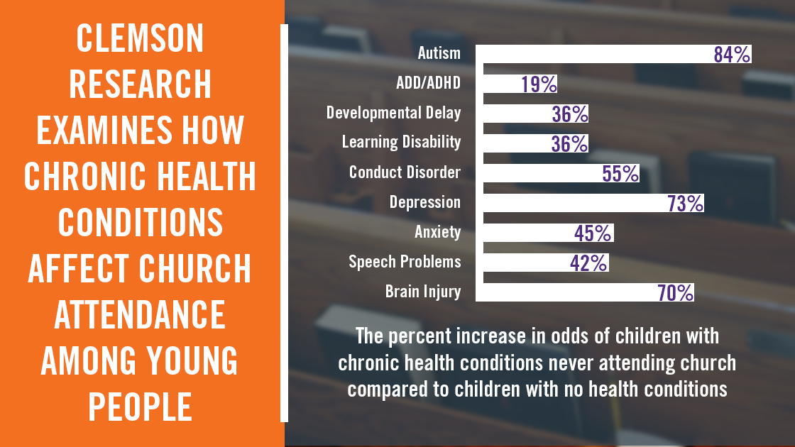
Whitehead AL. J Scientific Study Religion 2018;57(2)377-395.

Slide 4
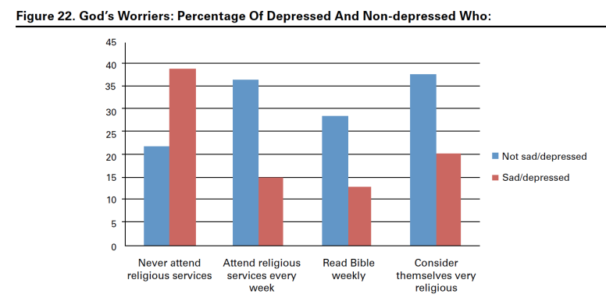
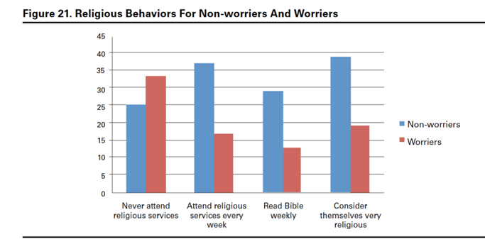
De
Depression and anxiety have a profound impact on church attendance and spiritual practice among adults
Dougherty et al. Baylor Religion Survey (2011)

Slide 5
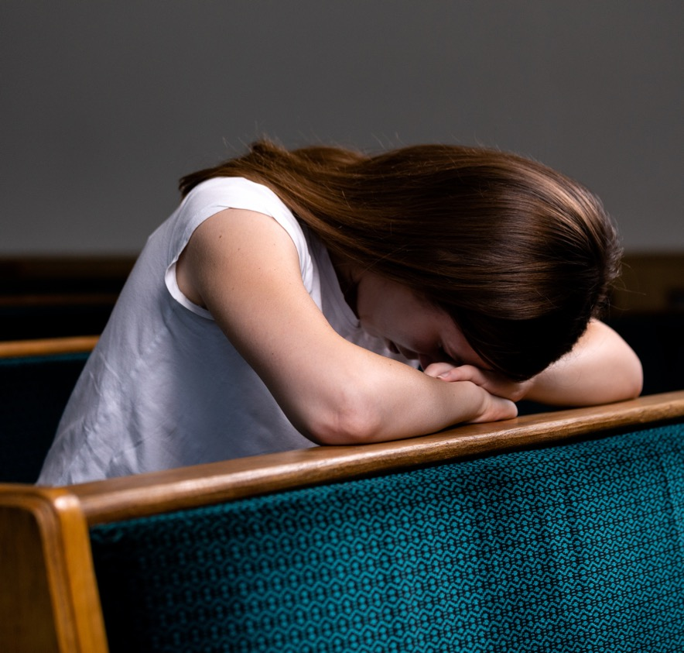
Can someone be disabled at church but function well in other activities?
For many, mental health disability presents some, but not all the time in some, but not all situations and environments.
Symptoms are often situation-specific

Slide 6
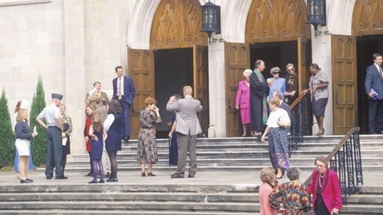
Why is church participation so difficult?
Traits associated with common mental health conditions often clash with “church culture” – how we expect people should act when we come together

Slide 7

Seven barriers to including families impacted by mental illness at church
Stigma
Anxiety
Capacity for self-control
Sensory processing
Social communication
Social isolation
Past church experiences

Slide 8

Stigma
WHAT THEN IS WRONG WITH THE “MENTALLY ILL?” THEIR PROBLEM IS AUTOGENIC; IT IS WITHIN THEMSELVES.
Jay Adams
Mental illness defined as sin, parenting problem
If it’s not a disability, why would disability ministry serve them?

Slide 9
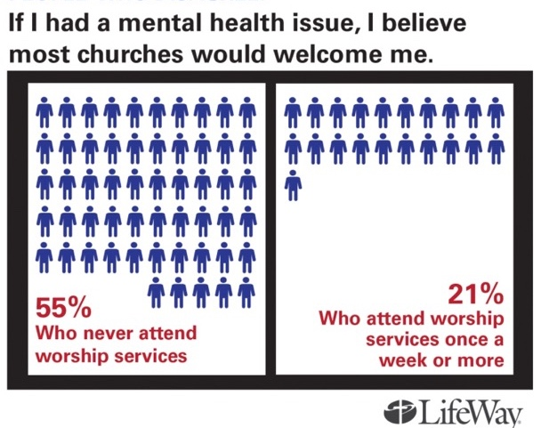
A widespread perception among adults outside of the church that persons with mental illness aren’t welcome…
Unchurched people don’t believe people with mental illness are welcome at church

Slide 10

Anxiety
People with anxiety overestimate threat, risk in unfamiliar situations
Social anxiety
Separation anxiety
Agoraphobia
Obsessive-Compulsive Disorder

Slide 11

What church activities are challenging for children and teens with anxiety?
Separating from parents at worship
Unfamiliar situations… retreats/mission trips
Self-disclosure in small groups
Large group social situations
Transitions between age-group ministries

Slide 12

Challenges at church for adults with anxiety
Visiting a church for the first time
Fear becoming focus of attention
Seating near an exit (agoraphobia)
Meeting new people
Joining a small group
Self- disclosure
Using the phone

Slide 13

Self-control
Executive functioning refers to cognitive abilities involved with modulating other abilities and behaviors.
Behavioral inhibition
Verbal working memory
Non-verbal working memory
Emotional self-regulation
Reconstitution

Slide 14

“People in the church believe they can tell when a disability ends and bad parenting begins.”

Slide 15

Sensory Processing
NOISE, LIGHT, TOUCH AND SMELLS THAT OTHERS FIND ENGAGING ARE AVERSIVE
Challenges for kids:
Pick up and drop-off times
High energy worship
Vulnerability to aggressive behavior when overstimulated
Challenges for adults:
Greeting times (hugging, handshakes)
Decibel level during worship
Multiple conversations within earshot

Slide 16

Social Communication
DIFFICULTIES AT CHURCH FOR PERSONS WHO STRUGGLE TO PROCESS SOCIAL CUES
Church-specific challenges:
Small talk
Small groups
Bullies
Unfamiliar situations

Slide 17

Social Isolation
HOW DO PEOPLE FIND YOUR CHURCH IF THEY DON’T KNOW SOMEONE ATTENDING YOUR CHURCH?
Parents less likely to connect with neighbors through children’s activities, friendships
Isolation as a symptom of depression, anxiety

Slide 18
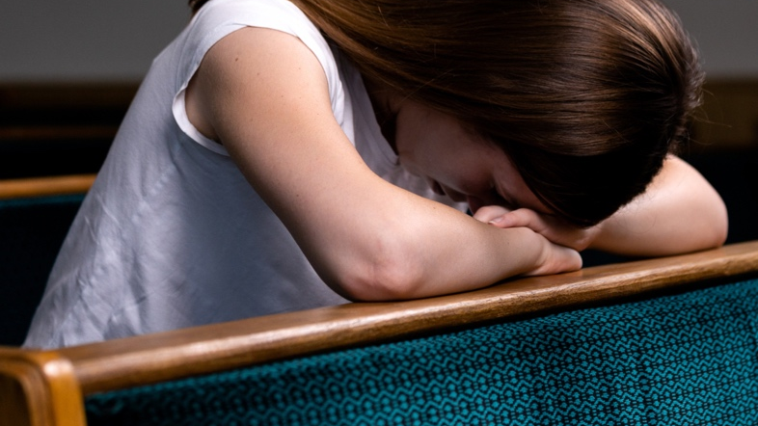
Past Experiences of Church
THE APPLE OFTEN DOESN’T FALL FAR FROM THE TREE!
Lack of support from church in a time of need
  No one noticed when they were missing
  No help offered when a child experienced struggles
Adults with mental health concerns as children never got in habit of attending

Slide 19

The foundation of Key Ministry’s mental health inclusion ministry model
Recognize non-essential features of ministry activities, environments, that make church attendance more difficult
Implementation of strategies across all areas of ministry to welcome children, adults and their families

Slide 20
Seven strategies for promoting mental health inclusion (TEACHER)
Assemble your inclusion team
Create more welcoming ministry environments.
Focus on activities central to spiritual growth
Develop a mental health communication strategy
Help families with their most heartfelt needs
Offer education and support
Empower your people to be responsible

Slide 21

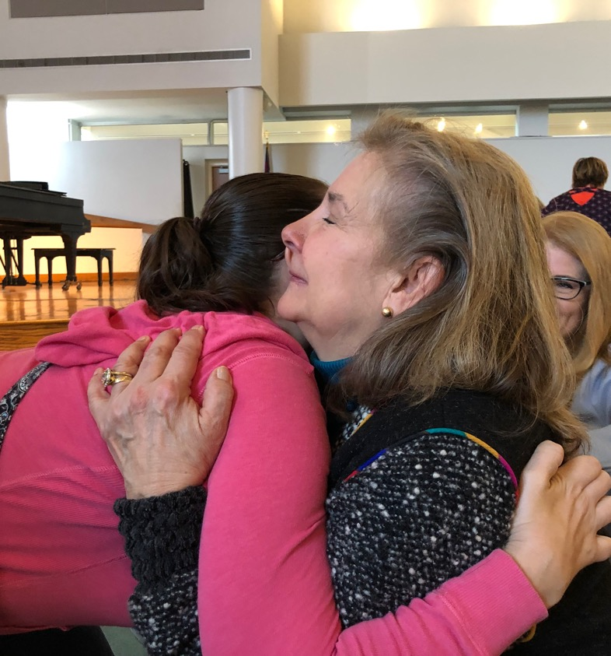
Five attributes of a mental health friendly church
Demonstrates an intentional inclusion planning process
Educates church staff, volunteers on mental illness
Implements a mental health communication strategy
Provides practical help to individuals, families affected
Offers mental health-specific education/support groups

Slide 22
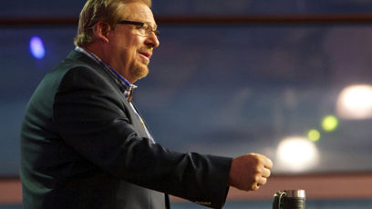
What churches are doing to communicate more effectively
Praying for persons with mental illness during worship
Sermon series on mental health-related topics
Facebook video targeting families with mental health issues
Interviews/prerecorded testimonies of respected members during worship

Slide 23

Mental Health Education and Support
Training for pastors, church staff, volunteers
  Seminaries
  Mental Health First Aid
  Trauma-informed care
Christian-based mental health education, support
  Fresh Hope
  Grace Alliance
  Celebrate Recovery
  My Quiet Cave
Mental health support
  NAMI

Slide 24
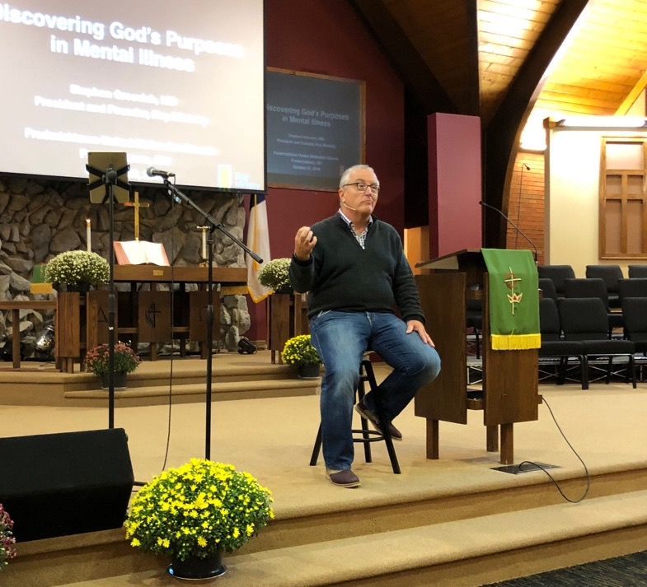
Mental Health Awareness Sunday
Strategy for introducing a mental health ministry
Outreach to friends, neighbors
Teaching on mental health-related topics
Great event for small-medium size churches
Church “conversation” can be very powerful!

Slide 25
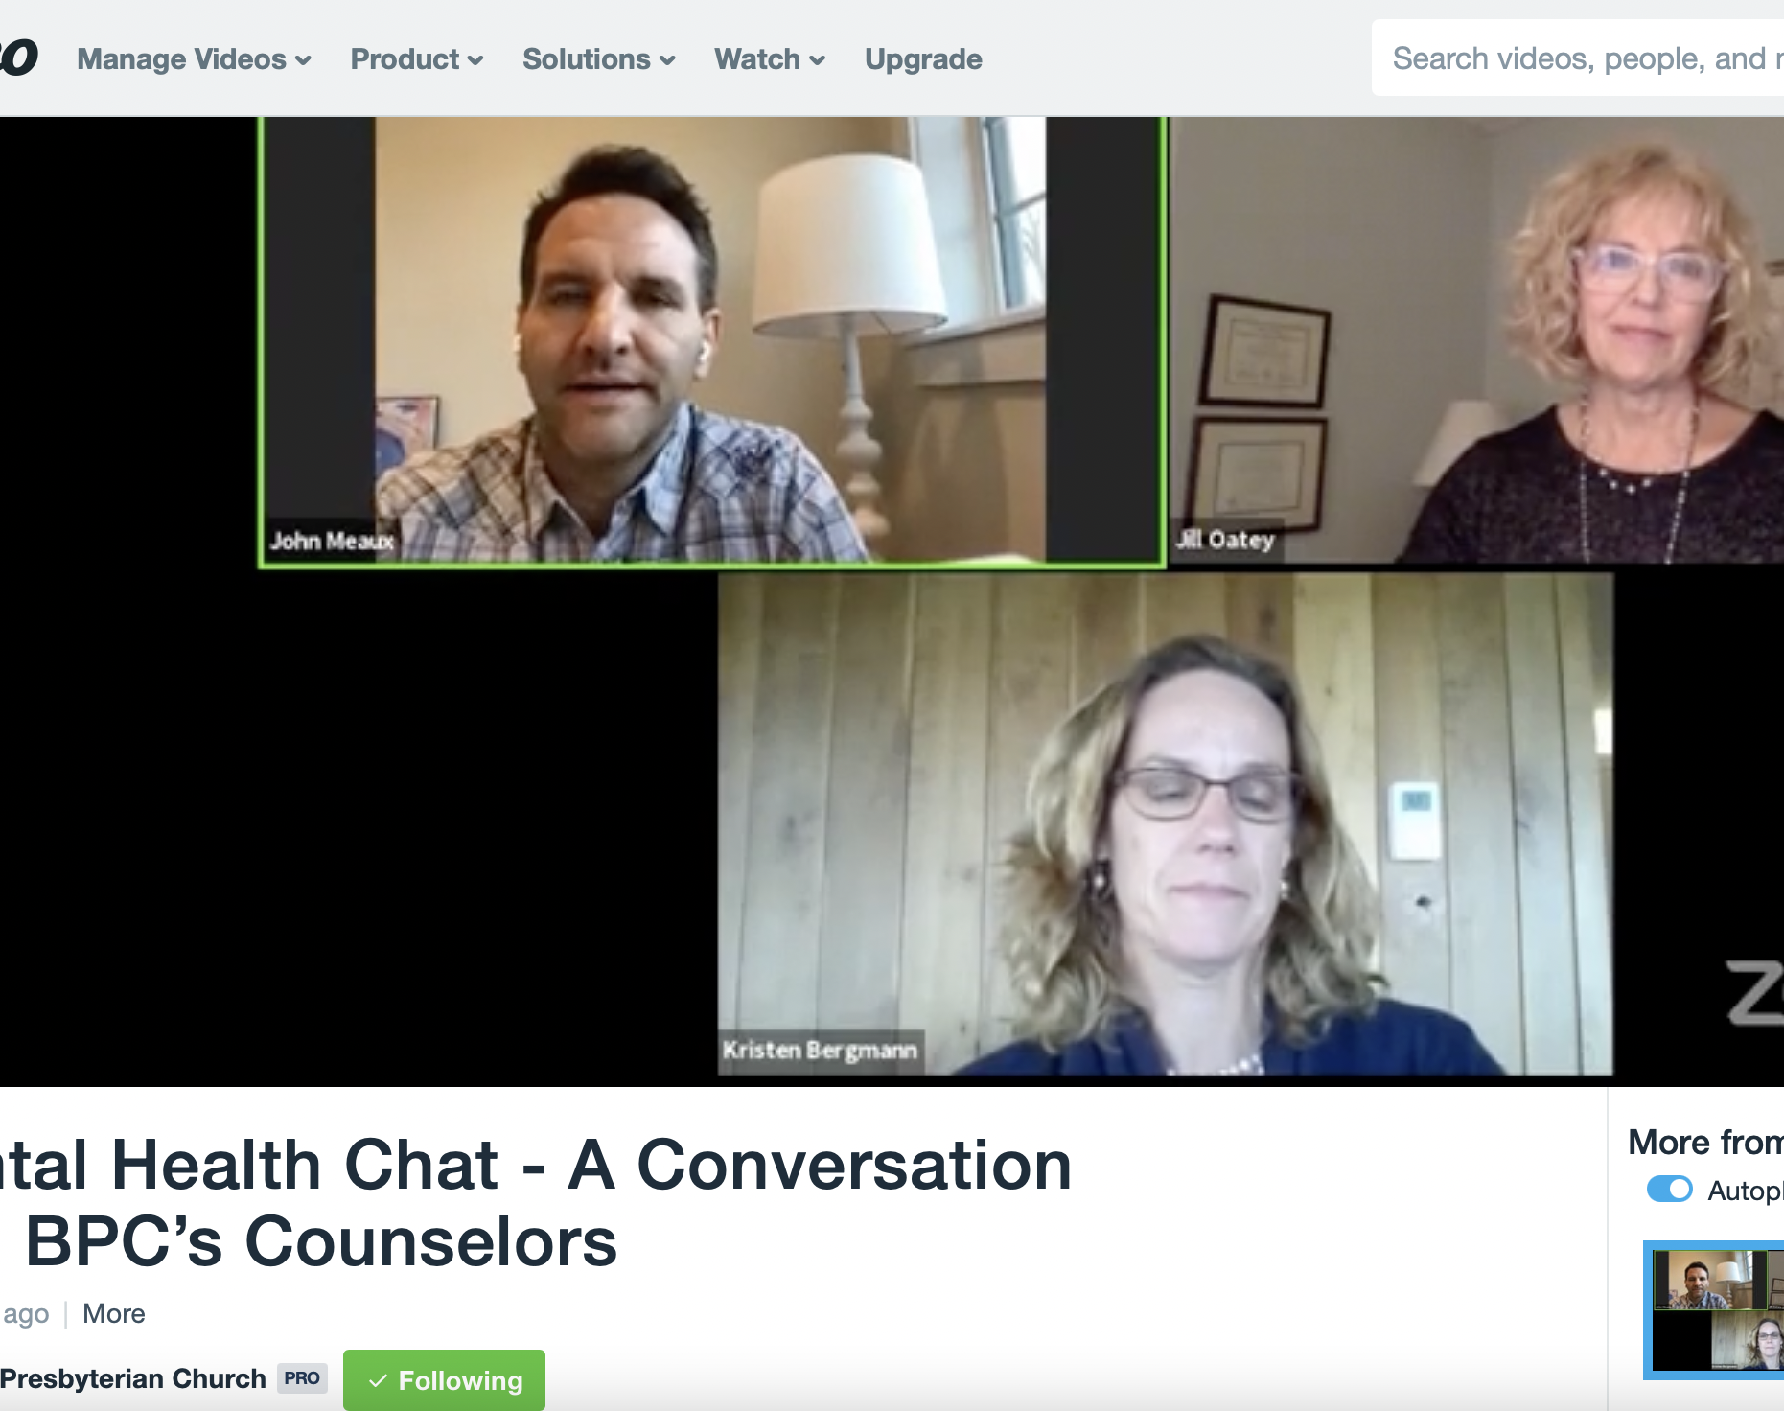
Other Innovative Practices
Online mental health “chats”
Establishing role for a “mental health liaison”
Mental health education cards/resource center in prominent location
Providing space for community agencies, professional counselors
  Khesed Wellness

Slide 26
Key principles for an effective mental health inclusion strategy…
Inclusion is a mindset – not a program
Kids with mental health issues have parents with mental health issues!
A good strategy benefits everyone and doesn’t require anyone to self-identify
Ministry owned by the people, supported by staff

Slide 27
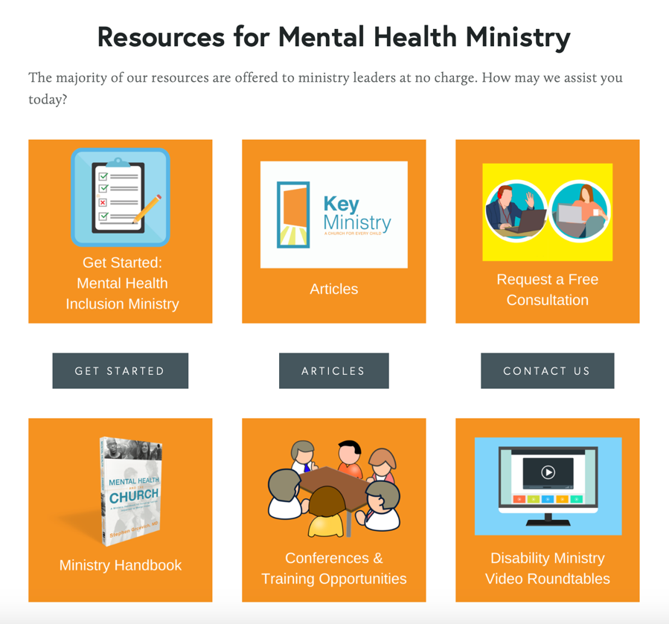
Help from Key Ministry
Training
  Conferences
  Video training
  Roundtables
Consultation to churches
Resources
  Networking with other ministries
  Social media, sermon videos, research
Someone to come alongside your ministry!

Slide 28

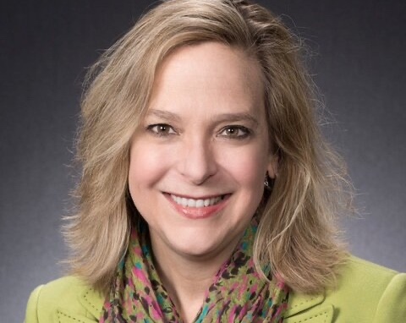
Connect with Key Ministry
keyministry.org
Facebook: Key Ministry
Twitter: @KeyMinistry
Catherine Boyle – Director of Mental Health Ministry
  catherine@keyministry.org
  steve@keyministry.org

