Slide 1

heidigoehmann.com
Building Resilient Youth Mental Health

Slide 2
heidigoehmann.com
This world is big and
I am small within it.
Notes:
Living life as a youth!
-easy to forget with age
-sense of powerlessness and authority over your own life
-expectations of others
-uncertain identity, lack of clarity

Slide 3
Resilience is an unnecessary necessity
in a broken world.
—youthesource, heidi goehmann

Slide 4
Resilience
STOP
Hold fast
Stand firm
Hebrews 12:1-3, Job 2:3, Romans 12:9
Exodus 14:13, Galatians 6:1

Slide 5
Resilience
STOP
Image: grass bending in the storm, tree blown over
Flexibility, lack of rigidity

Slide 6
Resilience =
STOP
“The capacity to come back from a struggle with renewed hope, life, and a greater ability to respond to future stressors.
The internal capacity of people to recover, gaining new insights, strengths, and capabilities we did not have before the struggle.”
(Finding Hope, CPH 2021)

Slide 7
Resilience
STOP
Foundations of Resilience:
Assume the struggle
Embrace the sorting & wrestling
Build belonging with validation
Connection & conversation build capacity
Notes:
Foundations of Resilience:
Assume the struggle - "life is hard and that is hard"
Embrace the sorting & wrestling - identity work
Build belonging with validation - intimacy work
Connection & conversation build capacity - invitation

Slide 8
Resilience
STOP
Types of Resilience:
*shame resilience/spiritual resilience
*emotional resilience
mental resilience
physical resilience
*relational resilience/social resilience
Notes:
Foundations of Resilience:
Assume the struggle - "life is hard and that is hard"
Embrace the sorting & wrestling - identity work
Build belonging with validation - intimacy work
Connection & conversation build capacity - invitation

Slide 9
Shame is...
STOP
"the intensely painful feeling or experience of believing that we are flawed and therefore unworthy of love, belonging, and connection."
(Brene Brown, Atlas of the Heart, 2021)
Notes:
Foundations of Resilience:
Assume the struggle - "life is hard and that is hard"
Embrace the sorting & wrestling - identity work
Build belonging with validation - intimacy work
Connection & conversation build capacity - invitation

Slide 10
Shame Resilience
STOP
brokenness & sin are struggles in me, put on me by others, around me in the world
brokenness & sin are NOT who I am
Notes:
Foundations of Resilience:
Assume the struggle - "life is hard and that is hard"
Embrace the sorting & wrestling - identity work
Build belonging with validation - intimacy work
Connection & conversation build capacity - invitation

Slide 11
Building Resilience
STOP
grounded confidence - realistic hope
strengths-focused - capacity
growth-orientation - everything is messy,
mentionable, & redeemable
Notes:
Foundations of Resilience:
Assume the struggle - "life is hard and that is hard"
Embrace the sorting & wrestling - identity work
Build belonging with validation - intimacy work
Connection & conversation build capacity - invitation

Slide 12
Emotions are...
STOP
sensations experienced within the body interconnecting metaphysically
purposeful informants, not leaders
something, not everything
process oriented, healing oriented
complex, complicated, comingled
Notes:
Foundations of Resilience:
Assume the struggle - "life is hard and that is hard"
Embrace the sorting & wrestling - identity work
Build belonging with validation - intimacy work
Connection & conversation build capacity - invitation

Slide 13
Emotional Resilience
STOP
  only through psychological safety
  built with agility & assurance
  mentionable and redeemable according to Mr Rogers and Jesus
Notes:
Foundations of Resilience:
Assume the struggle - "life is hard and that is hard"
Embrace the sorting & wrestling - identity work
Build belonging with validation - intimacy work
Connection & conversation build capacity - invitation

Slide 14
Life in Relationship
STOP
  Connection = how we get to relationship, intimacy, and belonging
  Relationship = the continuous state of being in connection
  Intimacy = specific relationships in our lives that are built with safety and knowing
  Belonging = experience of communal intimacy, sense that we are not alone but we have our people
Notes:
Foundations of Resilience:
Assume the struggle - "life is hard and that is hard"
Embrace the sorting & wrestling - identity work
Build belonging with validation - intimacy work
Connection & conversation build capacity - invitation

Slide 15
Relational Resilience
STOP
invitation more than expectation
define the circle of the relationship*
embrace the awkwardness and warmth
the redemption cycle of relationship*
Notes:
Foundations of Resilience:
Assume the struggle - "life is hard and that is hard"
Embrace the sorting & wrestling - identity work
Build belonging with validation - intimacy work
Connection & conversation build capacity - invitation

Slide 16
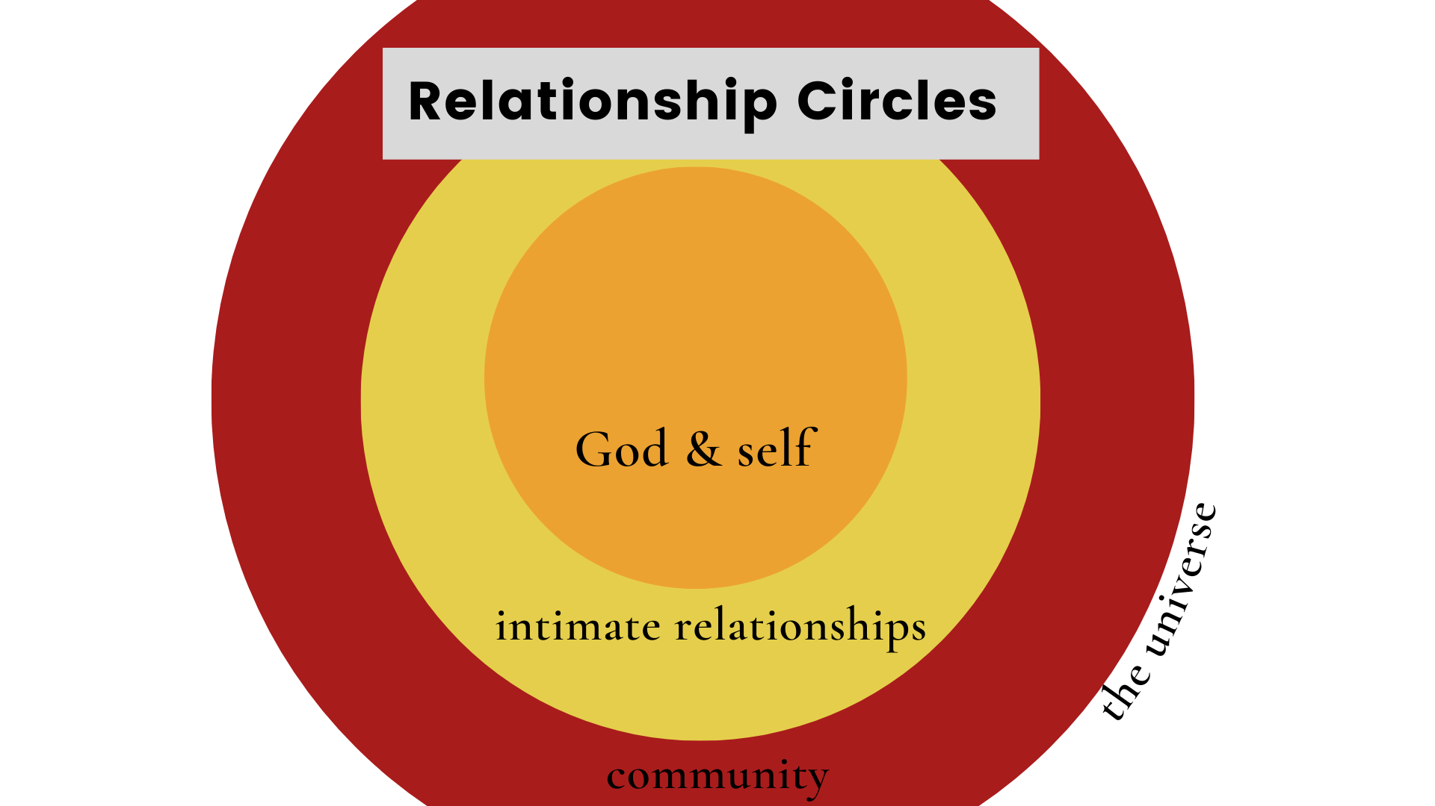

Slide 17
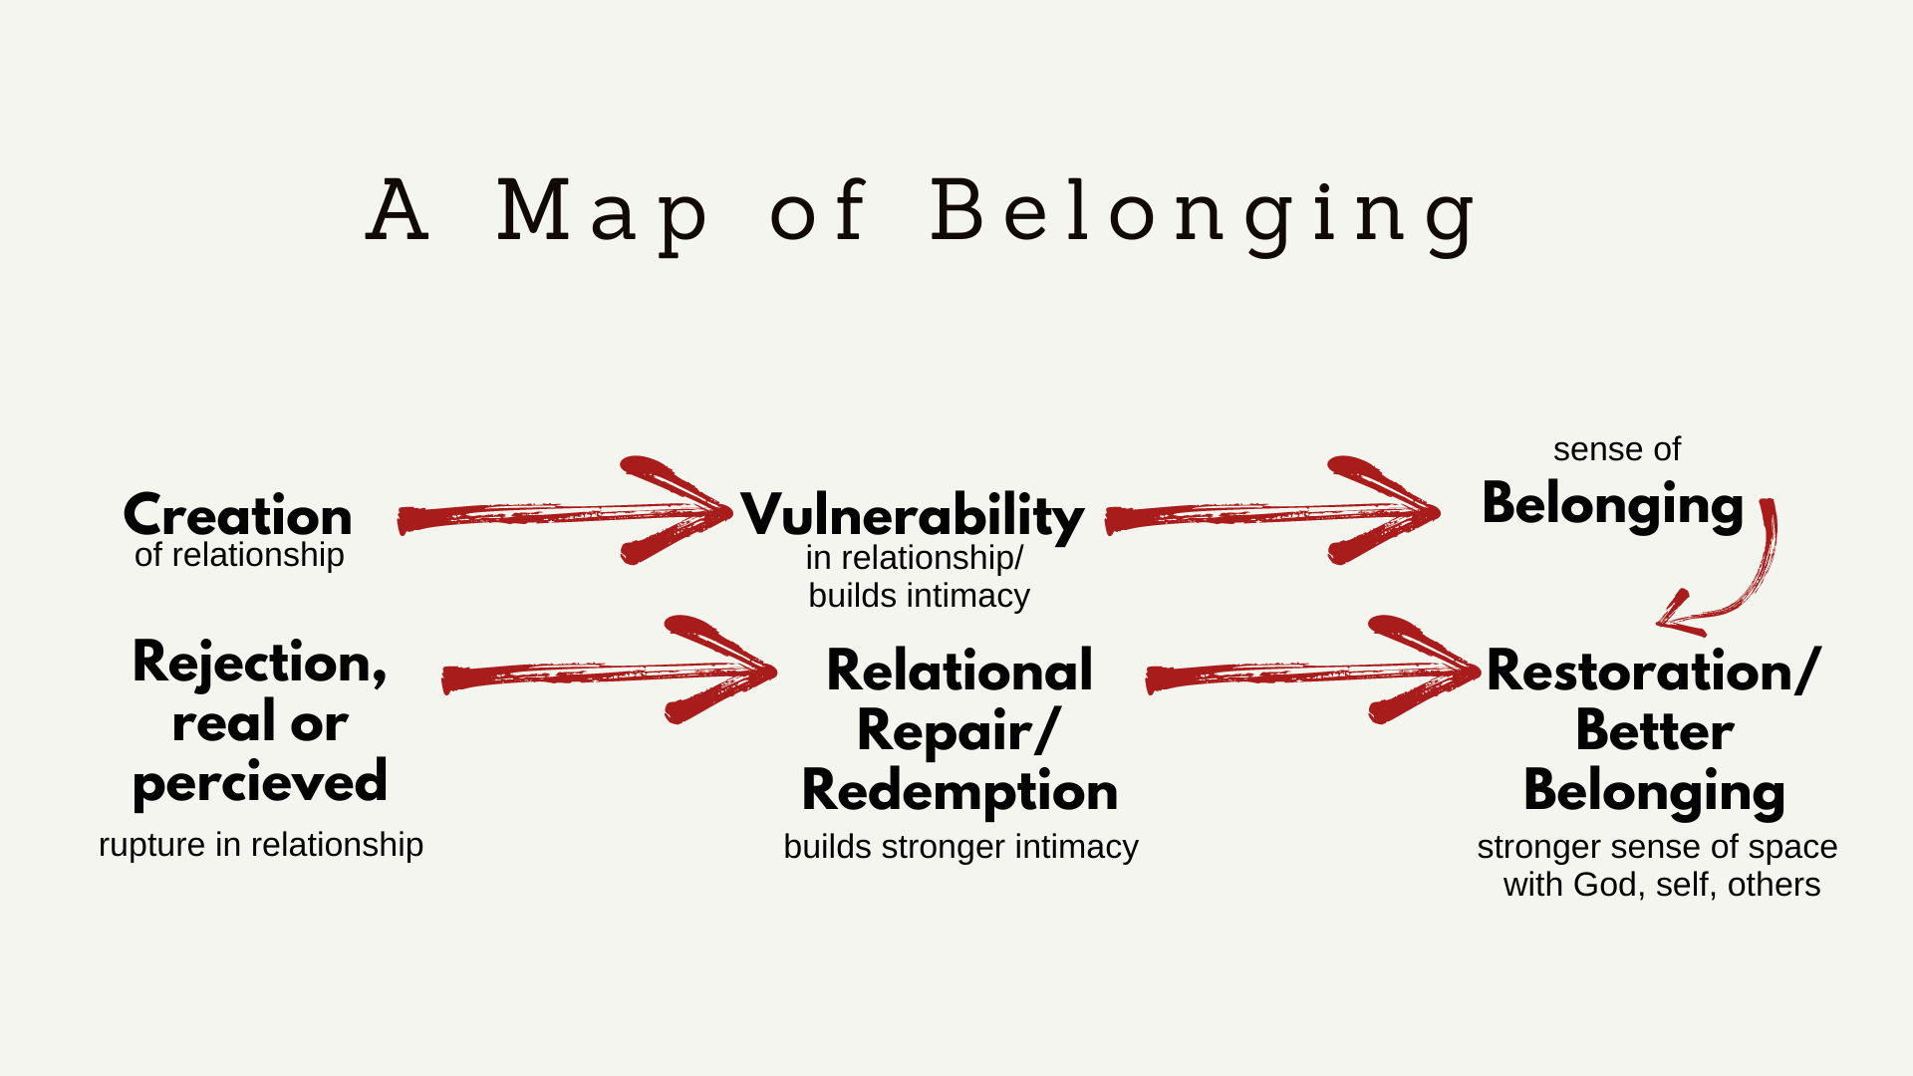

Slide 18
Question 1
Which areas do you see youth struggling the most? (Choose 1-2)
Identity/Worth
Emotions/Mental Health
Relationships/Social
Purpose/Direction
Spirituality/Hope
Other
heidigoehmann.com

Slide 19
Question 2
How many significant adult relationships in a young person’s life give the greatest likelihood for that youth to exhibit resilience?
2
3
5
7
heidigoehmann.com

Slide 20
Question 3
What is the hardest part of supporting youth mental health?
Hot topics
Poor decision making/confronting mistakes
All the emotions
No one seems to want to hear from me
No one seems to care
self-care/burnout
Other
heidigoehmann.com

Slide 21
Question 1
Which is not one of the types of resilience discussed today?
Emotional
Cognitive
Relational
Shame
heidigoehmann.com

Slide 22
Question 2
Which word is connected to emotional resilience?
Positive
Change
Agility
Stuffing
heidigoehmann.com

Slide 23
Question 3
What is the second step in building belonging?
Repair
Creation
Vulnerability
Restoration
Rejection
Belonging
heidigoehmann.com

Slide 24

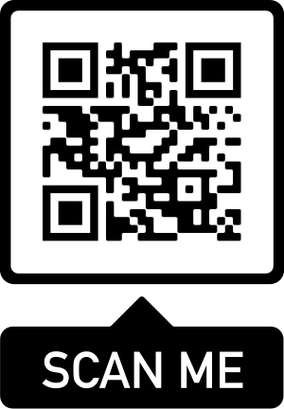



heidigoehmann.com

