Slide 1


Date of Presentation
Taste of
Companionship Presentation
Presented by:
Rev. Jermine Alberty, M. Div.
Executive Director
Pathways to Promise

Slide 2

Companionship: History & Roots
Companionship developed as a way of outreach and engagement with individuals who were homeless and facing mental illness.
Companionship is rooted in the caring practices of spiritual community, going back to the most ancient of faith traditions.
Companionship is a principled, practical response to the suffering and struggle of our neighbors
Rev. Craig Rennebohm, creator of the Companionship model.

Slide 3


The Companionship Movement
Companionship is managed,
operated and disseminated by:

Slide 4
Companionship
Companionship is a practice of presence, a relationship responding to isolation and suffering and supportive of healing and recovery.
Companionship welcomes the stranger, building a circle of care with individuals who are facing emotional and mental health challenges.

Slide 5

OUR MISSION
As companions, we act on our concern for another person offering the encouragement of five basic practices: hospitality, neighboring, journeying side-by-side, listening, and accompaniment.

Slide 6

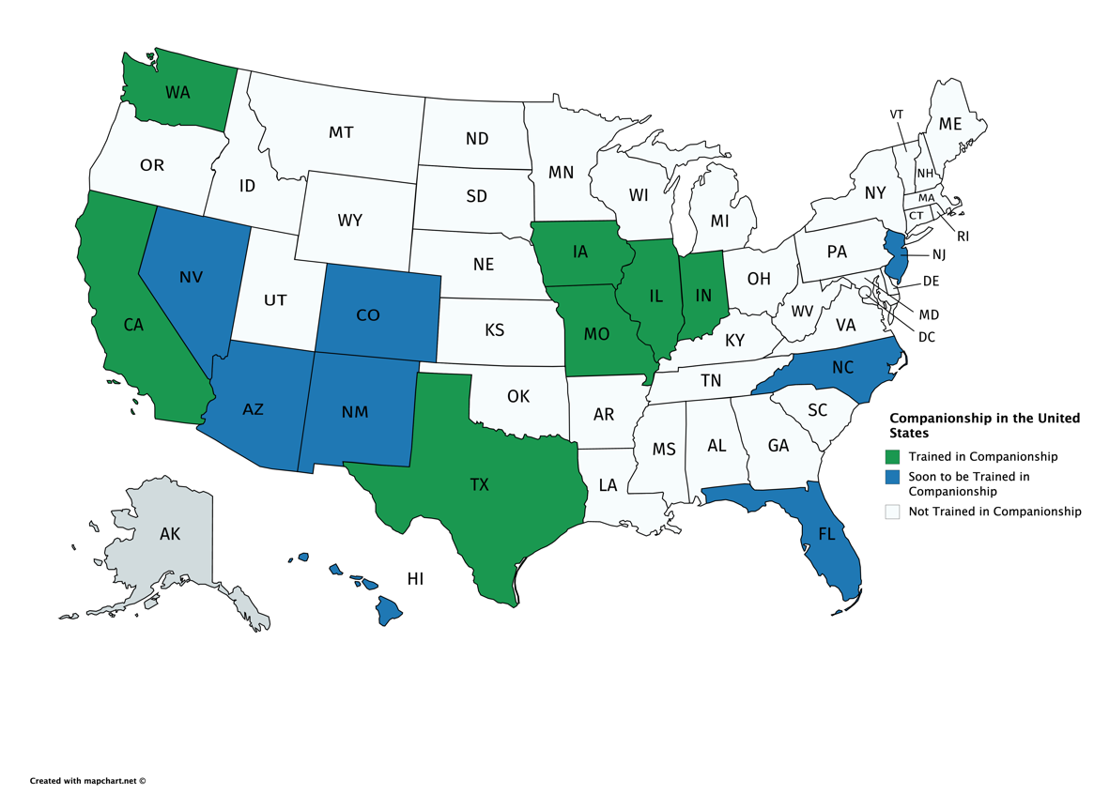
Who We’re Reaching
Notes:
[This graphic will need to be updated semi-regularly – check for the updated ALGEE-ometer at http://www.mentalhealthfirstaid.org/cs/algee-ometer/]

Slide 7
Getting Started: How does Companionship Begin?
Companionship is part of a larger process of outreach and engagement that begins even before we are consciously aware of another’s distress and ends in mutuality.
We sense another’s hurt; our own feelings and emotions are stirred; we become concerned and act.

Slide 8
Companionship is Part of a Process
Companionship developed as the core component of an outreach and engagement process that moves from observation and approach into the practices of companionship.

Slide 9
Companionship is Part of a Process
Companionship supports another person in building partnerships with others.
Companionship ends in mutuality, recognizing we are in community and each have our own circle of ongoing care.

Slide 10
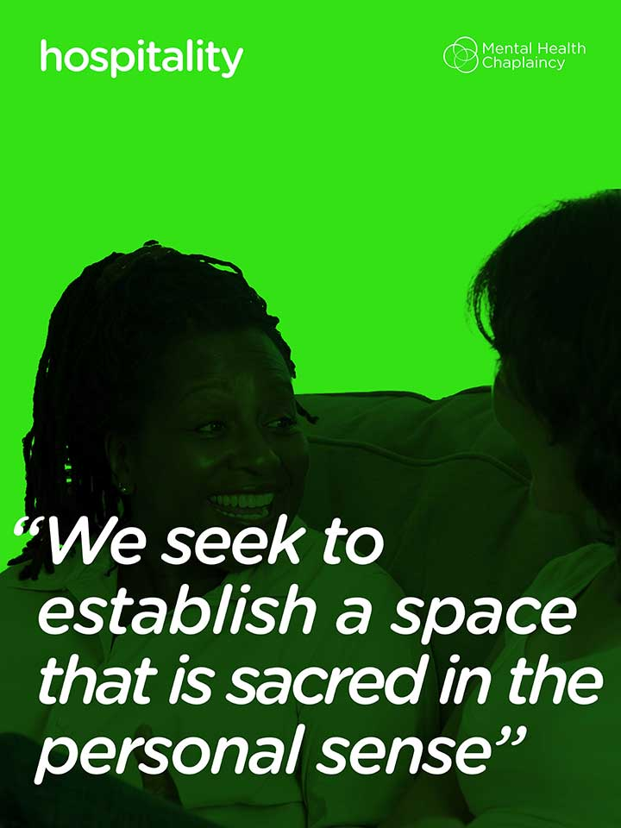
Hospitality
Notes:
creating safe space; respect; rest and refreshment.

Slide 11
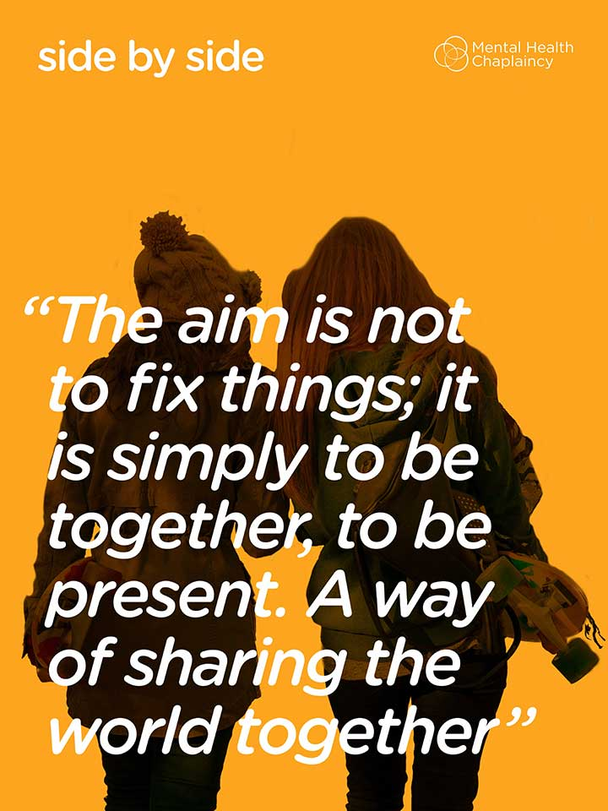
Side by Side
Notes:
looking out at the world together; grace, not force; honoring our differences.

Slide 12
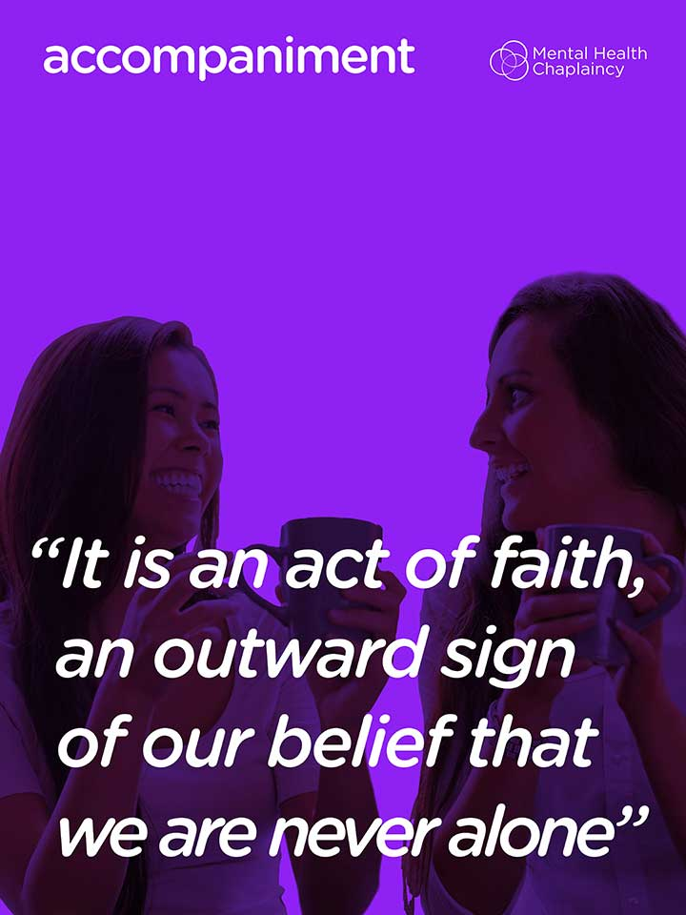
Accompaniment
Notes:
attending to expressed needs; exploring resources; intercession.

Slide 13

Listening
Notes:
listening to another’s story, hearing the person’s own account, beginning in the now, exploring gently the past and what the future holds

Slide 14
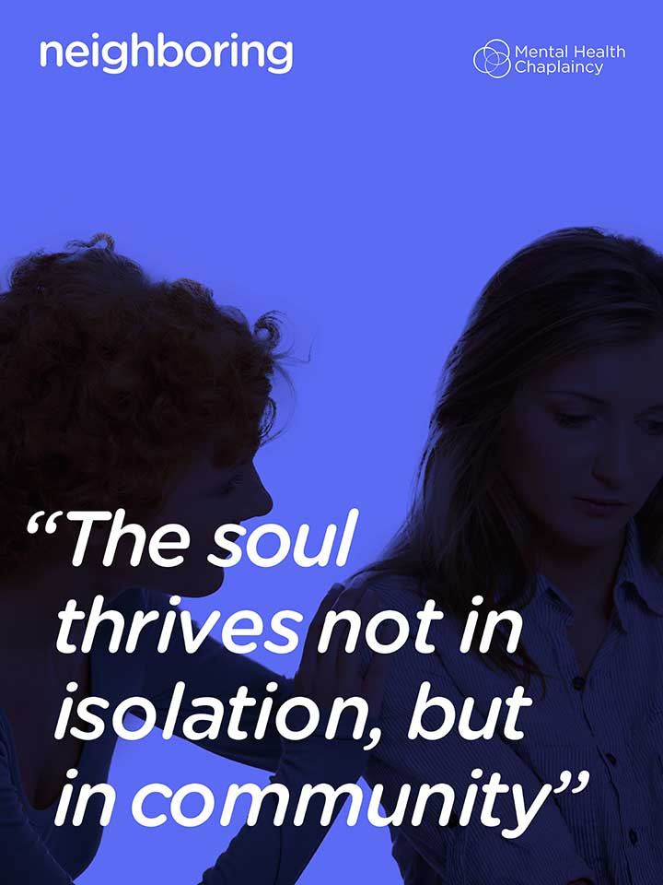
Neighboring
Notes:
affirming what we have in common, setting aside power and privilege; proceeding as equals.

Slide 15

Stop the Stigma
Think of all the negative words we have that put down people who are facing an emotional struggle: “loony,” “nuts,” “mental,” “crazy,” “psycho,” “bananas,” “weirdo,” “mad,”

Slide 16
Addressing Stigma:
Is Companioning Dangerous?
Studies indicate that individuals with a mental illness are no more violent than others.
Companionship does not make judgments; Companions seek to understand.
Companionship is not an emergency response or crisis intervention. If you do not feel safe, don’t companion.

Slide 17
Five Principles of Companionship
Principle 1. Companionship is a Basic Human Relationship

Slide 18
Five Principles of Companionship
Principle 2. Companionship is not about “Fixing It

Slide 19
Five Principles of Companionship
Principle 3. Companionship is a Public Relationship, Exercises.

Slide 20
Five Principles of Companionship
Principle 4. Companionship Comes to an End.

Slide 21
Five Principles of Companionship
Principle 5. Companionship is a Spiritual Journey

Slide 22
Companions can use Companionship to assist those with various challenges
Trauma and anxiety
Children’s mental health issues
Mental Illness
Substance Use Disorders
Issues of Aging
Poverty, Discrimination, Inequality and Economic Injustice, Housing Insecurity

Slide 23
Companionship Workshop
A 4-hour in-person or virtual training designed to interactively help individuals gain the knowledge, skills, and confidence to move beyond the serving counter and into genuine relationships with people in need.
You will learn ways to embody the 5 Practices of Companionship, how to honor your own limits throughout such work, and to understand the depth at which
Companionship has the power to shift a person’s perspective and life.

Slide 24
WHO SHOULD TAKE A COMPANIONSHIP COURSE?
• Faith Communities, including ushers, social justice and pastoral care teams
• Community Based Organizations
• Not-for-Profits
• Government agencies
• Peer Support Specialists
• Any secular or faith-based communities engaged with and supporting those who are disadvantaged through practices of hospitality and outreach

Slide 25
Companionship Instructor Training
A 2-day in-person training or 1 ½ day virtual training designed to give you the skills, tools, and support you need to successfully bring Companionship to your community and effectively communicate the transformational power of moving from transactional engagement to relational engagement.

Slide 26
Companionship Training
Interested in setting up a Companionship Training or the Train-the Trainer. We encourage you to email
admin@pathways2promise.org
or visit our website at https://www.thecompanionshipmovement.org/

